Slide 1
Put Attention because: Attention is all you need ☺

Slide 2
Agenda
Refresher → Architecture
RE-check deeper the blocks
FFN
Linear Transformation
Technical → Understanding Operations & Dimensions
Inference
Training
Conversation → Parallelization
Implement this from scratch?
General Discussion.
Note: Conversation and Recommendation → Material

Slide 3
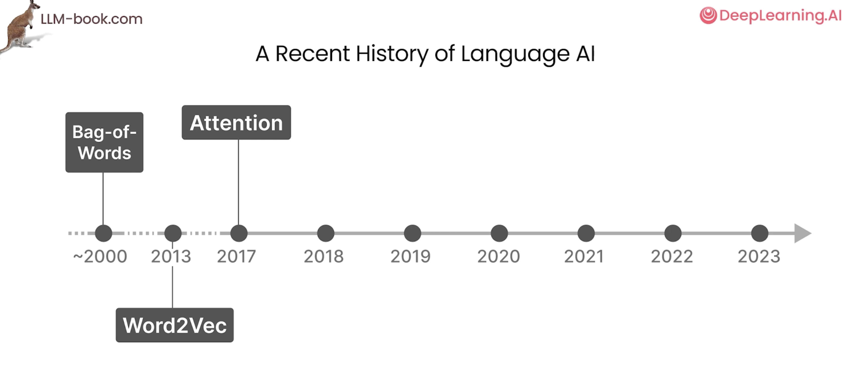

Slide 4
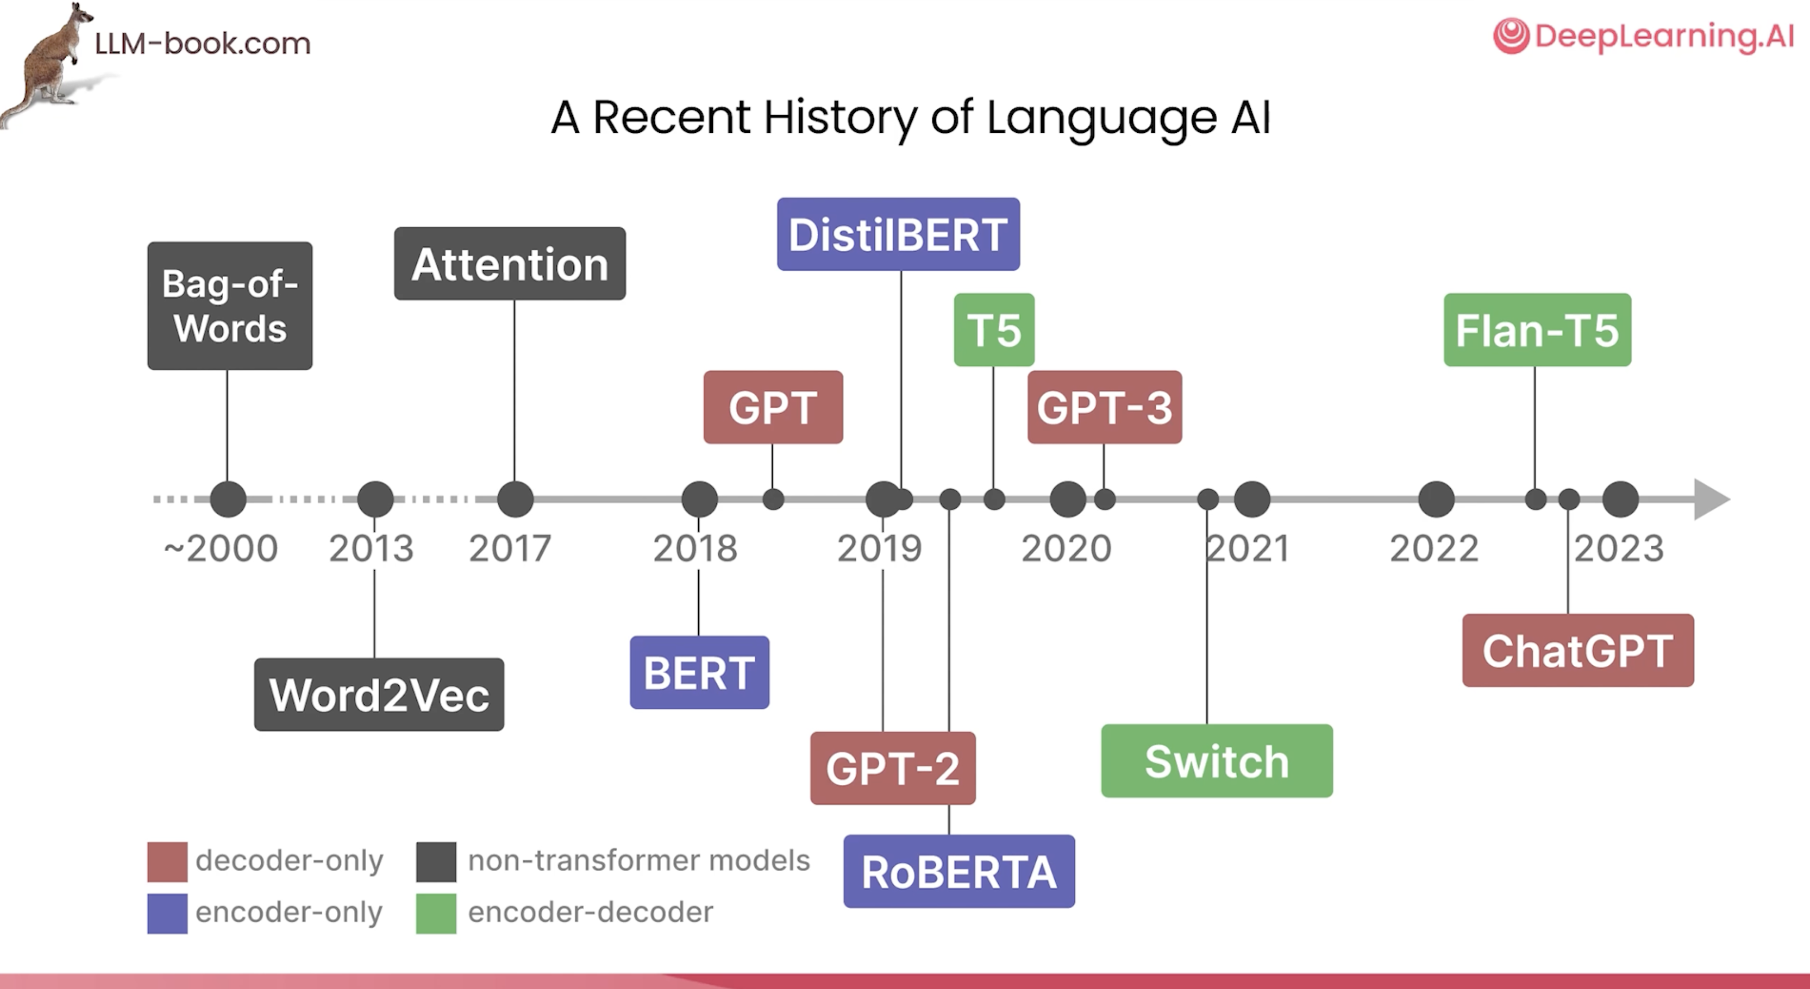

Slide 5
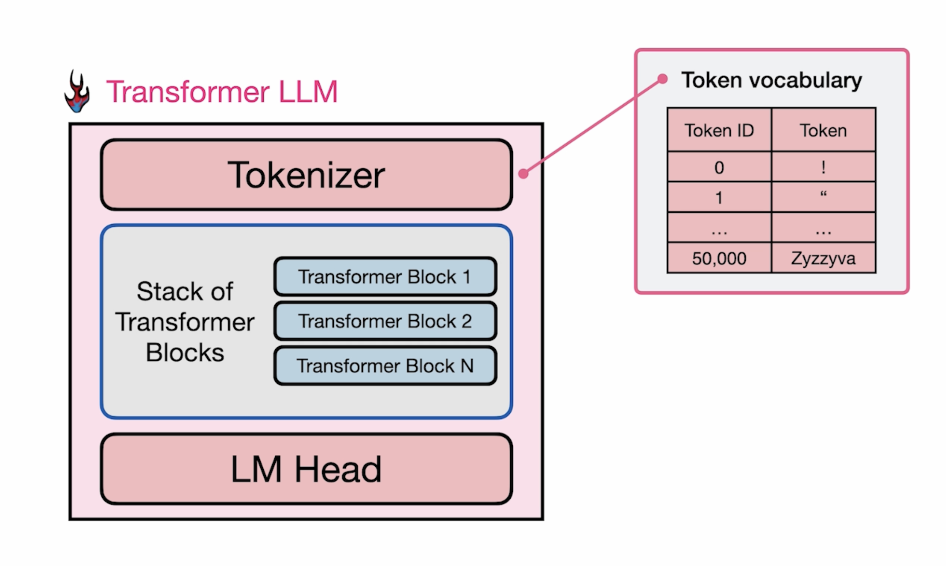
Inputs

Slide 6
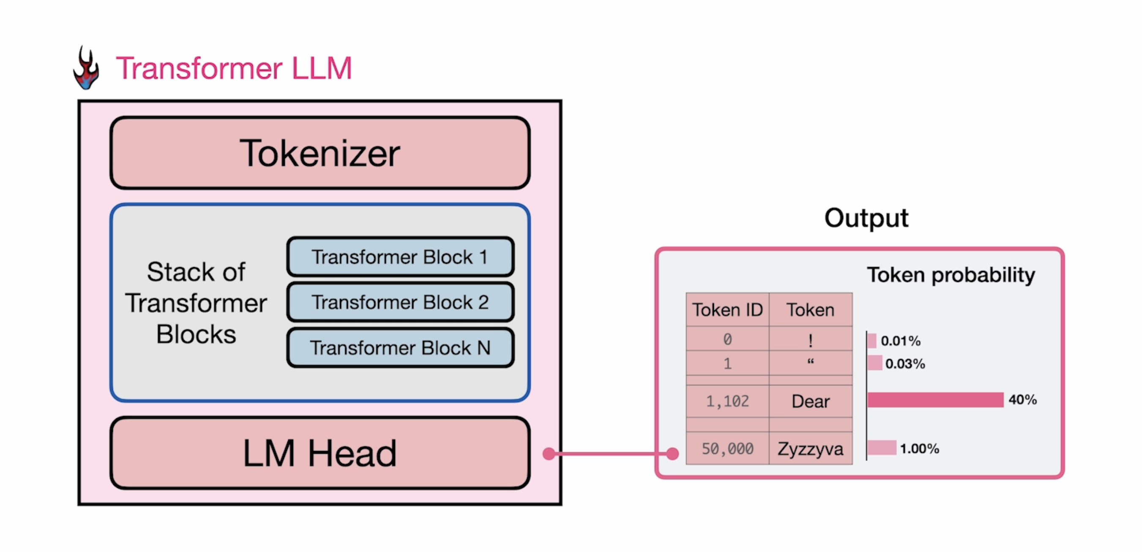
Outputs

Slide 7
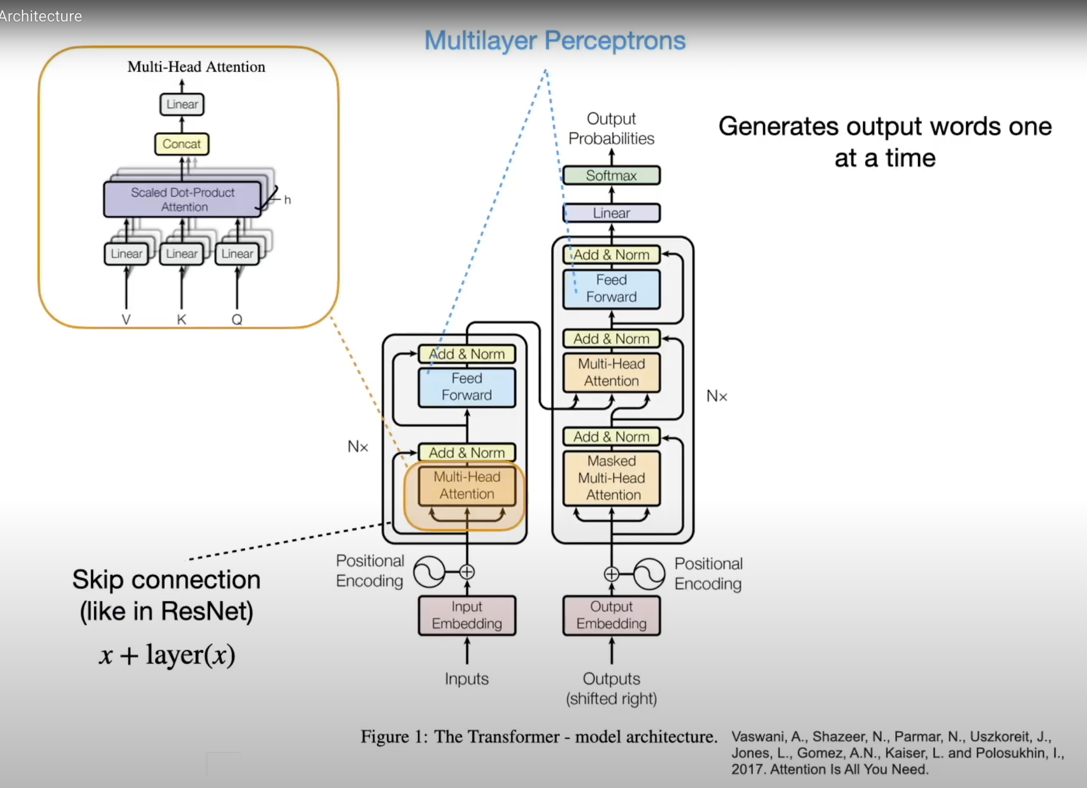
Notes:
Yeah, so here it is, here, that's the transformer architecture. And yeah, I know it looks pretty complicated at first glance. There are lots of little details, but we will be able to understand it by, yeah, tackling it one thing at a time.
So I made a couple of slides where I will explain all these little details going on here. So in this slide, let's start with the big picture. So we can see the big picture is that we have two parts and encoder.
And decoder here. And the encoder receives input words, so that could be a sentence, it will reproduce, uh, representation of that, that is then passed to the decoder, together with outputs, shifted outputs. I will get back to that later in a later slide.
But the big goal here is that it will produce the output probabilities for the words to be generated. So it's generating a sentence, and you can think of it as, let's say, translating a sentence. It reads an input sentence, and then
it translates the sentence by generating one word at a time.
And there are some familiar parts to it. So, first of all, notice we have the multihead attention here. That is what we talked about in the previous slide so much.
So that's the multi detention from the previous slide that we talked about. It also appears here, and here, there's actually a masked version. We will talk about the masked version, also in a separate slide.
Other things you might notice here is also, yeah, that we have skip connections. So these skip connections are essentially the residual connections that we talked about in the residual network, in the scene N lectures, similar concept, where we add the input to the output of something that went through a layer, right? So what we are doing here is we are, let's say, taking this one, this input here, and we are adding it at this stage after the multihead attention layers.
We're doing the same thing here. So here we are optionally skipping the feet forward network. So, for instance, if this is not learning anything useful, then we will have just forwarded the input here.
So this skip connection is essentially adding it. And this is also why, we have certain dimensions. So, originally the input embedding here is the sentence length T. Times 512.
So we have input embedding size of 500 12 in the original paper. They define it as 512. And what comes out of here, of the motiate attention, is also a 512 dimensional embedding that is so that we can then add those together.
So that's why we have the same dimensions. Same is true for here and here. So the multilayer perceptron layers here, feet forward, or multilayer deceptron layers.
They also, they are matrix, essentially, WO, which is 500, 12 is the number of columns. So it's 500, 12 times 500, 12. What else?
Yeah, I think this is maybe it for this slide, so I don't want, like I said, I don't want to talk too much about every detail in one particular slide, because then it gets too cramped. Maybe one more thing, highlighting here, there are more residual connections, also, in the decoder.

Slide 8
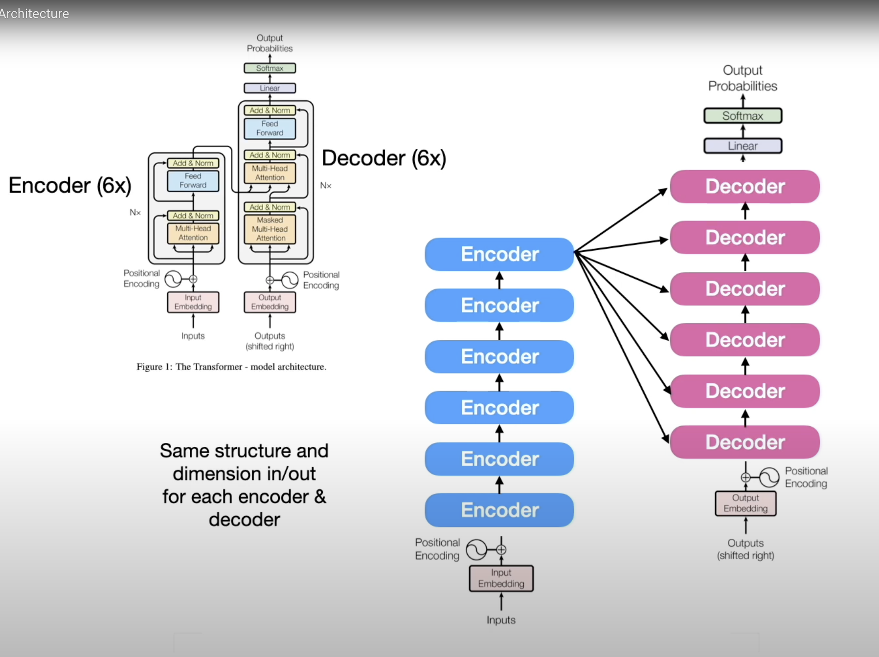
Notes:
Speaking of which, so the encoder and decoder parts are also repeated, so you can maybe see in a small fund, there is this NX, so this just means that they are repeating the encoder blocks and decoder blocks a couple of times.
So, in fact, in the original paper, they repeat that six times, so we have six in corners, and six decoders. The structure of the encoders and the decoders the same is just repeated. No weight sharing.
They are separate, so they are separate encoders, but they have exactly the same structure,

Slide 9


Slide 10
5
4
3
2
1
Notes:
Floor 1: Input Embedding (Turning Words into Numbers)
Computers don't understand words; they understand numbers. The first job of the Transformer is to convert each word (or, more accurately, each "token") into a high-dimensional vector—a list of numbers. This floor provides the raw material for the model.
These aren't just random numbers. Each vector is "semantically-rich" and designed to capture the word's semantic meaning—its fixed, dictionary definition, isolated from any sentence. The power of these context-free embeddings can be illustrated with a famous riddle:

Slide 11
5
4
3
2
1
Input Embedding (word into numbers)
Notes:
Floor 1: Input Embedding (Turning Words into Numbers)
Computers don't understand words; they understand numbers. The first job of the Transformer is to convert each word (or, more accurately, each "token") into a high-dimensional vector—a list of numbers. This floor provides the raw material for the model.
These aren't just random numbers. Each vector is "semantically-rich" and designed to capture the word's semantic meaning—its fixed, dictionary definition, isolated from any sentence. The power of these context-free embeddings can be illustrated with a famous riddle:
King - Man + Woman = ?
The answer is Queen. This arithmetic works because the vectors for these words capture concepts like royalty, gender, and authority. The vector for "King" contains the "essence" of royalty and maleness. By subtracting the "maleness" vector and adding the "femaleness" vector, we arrive at the vector for "Queen."
In the original "Attention Is All You Need" paper, these vectors had 512 dimensions, meaning each word was represented by 512 different features.

Slide 12
King – Men = Queen?

Slide 13
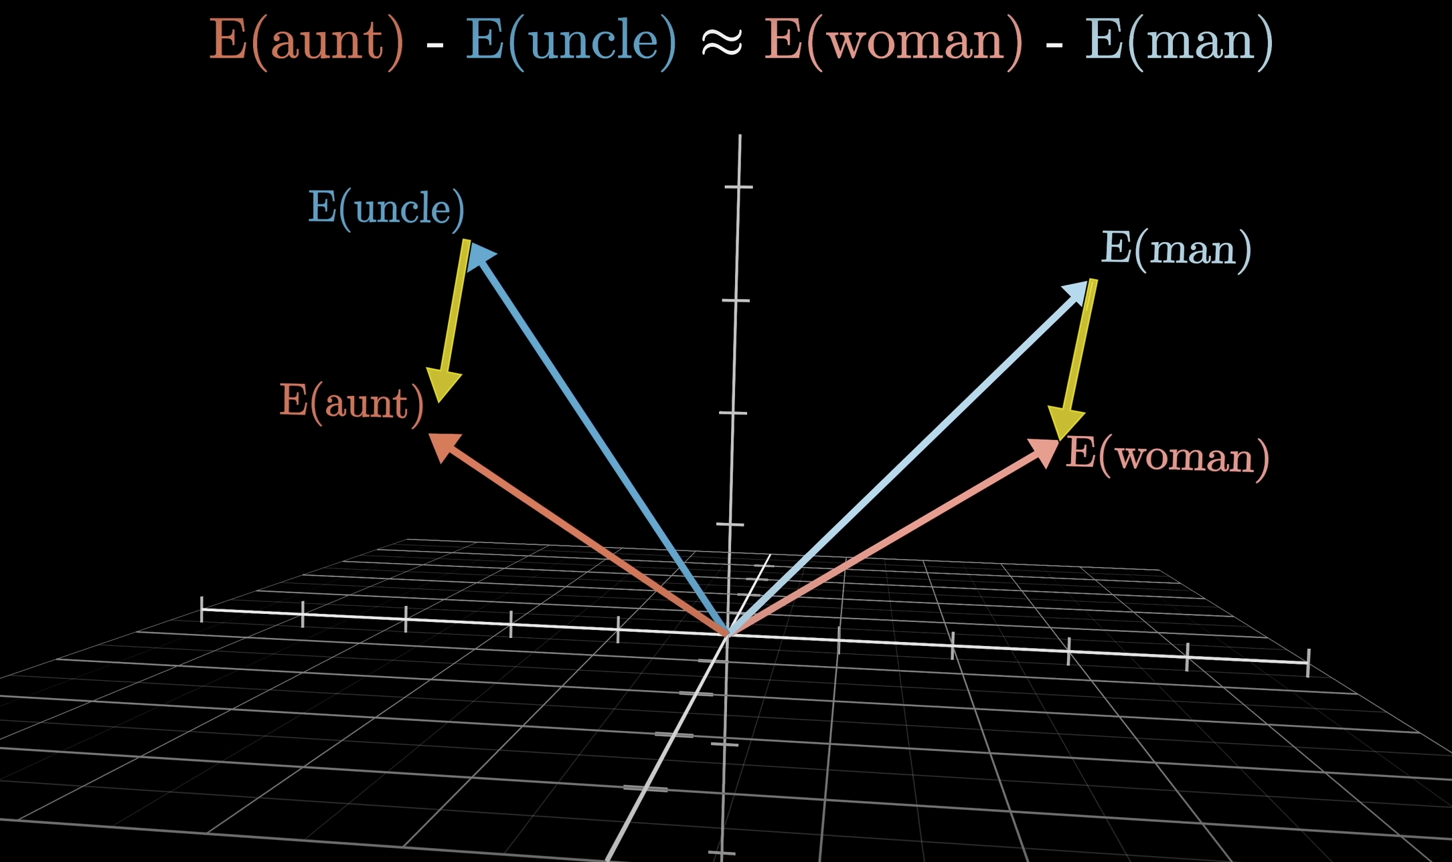
Notes:
Embedings directions in high dimensional space correspond with semantic meaning

Slide 14
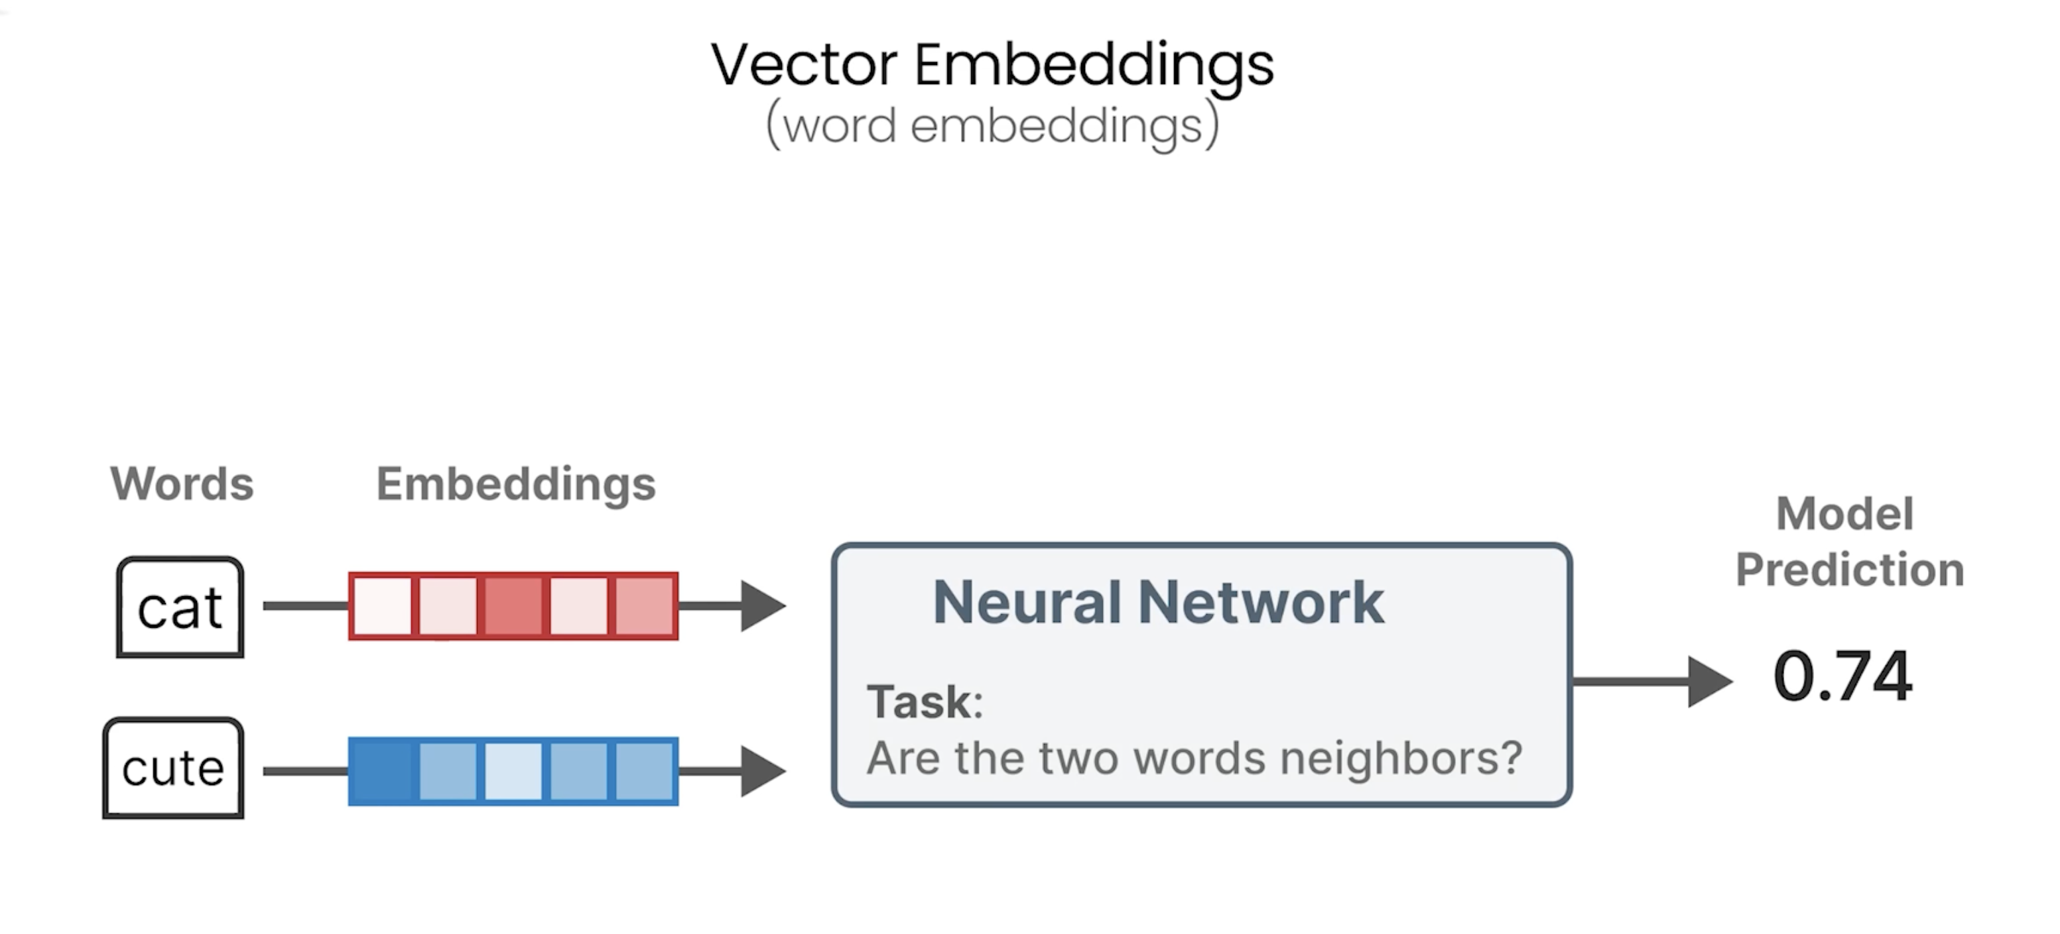

Slide 15
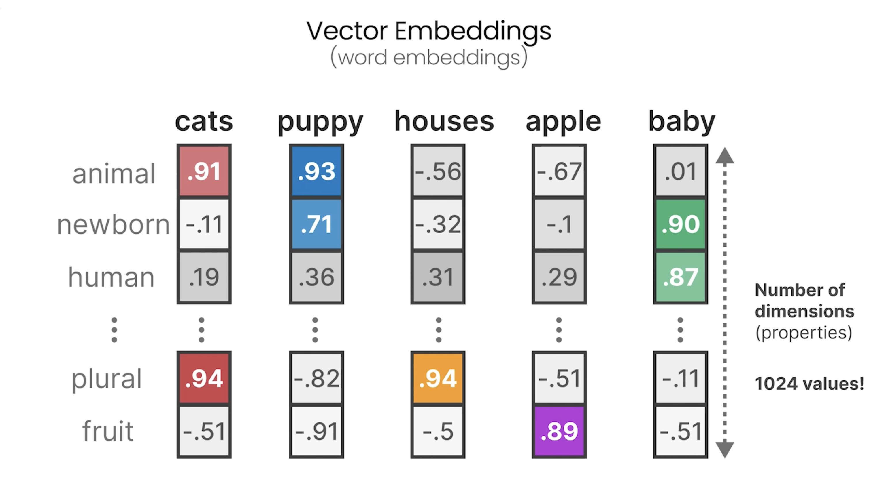

Slide 16
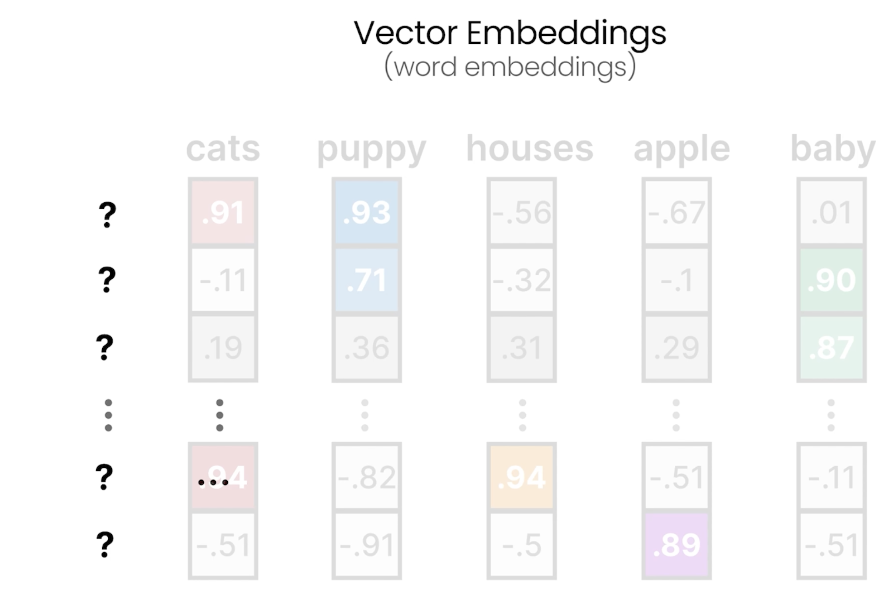

Slide 17
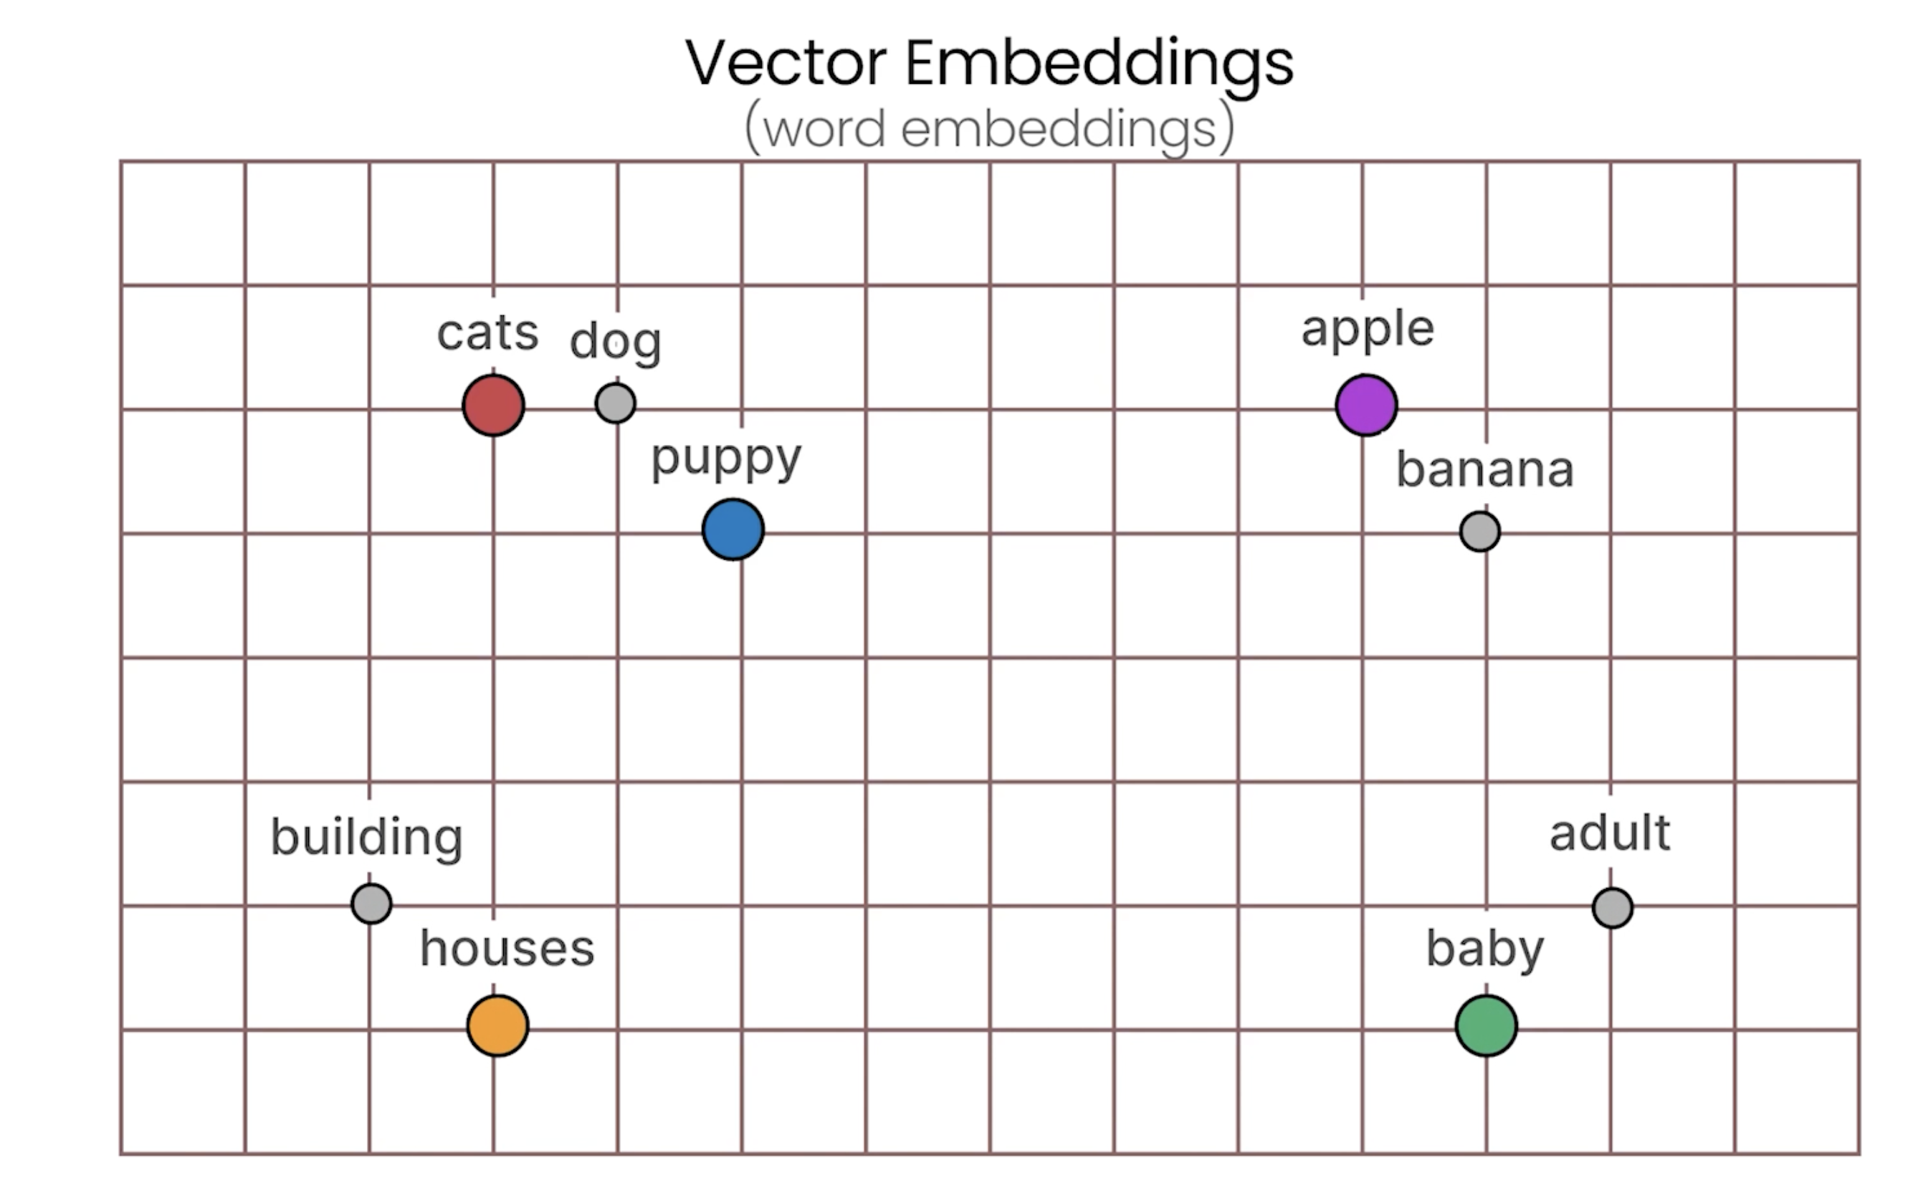

Slide 18
5
4
3
2
Positional Encoding (Adding Sense of Order)
1
Input Embedding (word into numbers)
Notes:
A key advantage of Transformers is speed. Unlike older models that read words one by one, Transformers process all the words in a sentence at the same time (in parallel). However, this creates a problem: the model inherently loses the original word order. This floor adds the first layer of relational information: order.
Word order is critical for meaning. Consider these two sentences:
• horses eat apples
• apples eat horses
They use the exact same words, but the order completely changes the meaning from a factual statement to a nonsensical one.
The job of this floor is to fix this. It adds a small "tag"—another vector—to each word's embedding. This tag doesn't change the word's meaning, but it encodes its position in the sentence (e.g., 1st, 2nd, 3rd). This gives the model a sense of order, even while it processes everything in parallel.

Slide 19
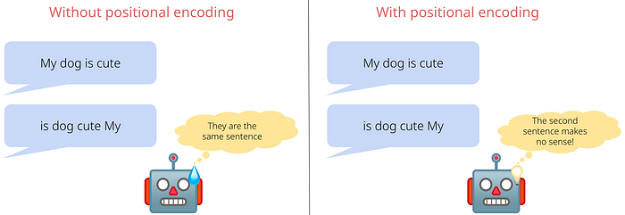
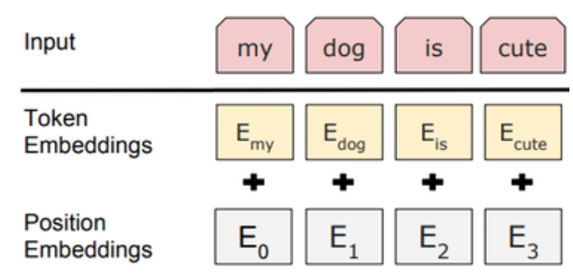

Slide 20
5
4
3
Attention Mechanism
2
Positional Encoding (Adding Sense of Order)
1
Input Embedding (word into numbers)
Notes:
This floor is the engineering heart of the Transformer. Here, we move from simple definitions to rich, contextual understanding. On Floor 1, we captured semantic meaning. On this floor, the raw semantic meaning is transformed into dynamic, contextual meaning—how a word's meaning changes based on the words around it.

Slide 21
5
4
3
Attention Mechanism
2
Positional Encoding (Adding Sense of Order)
1
Input Embedding (word into numbers)
Notes:
The attention mechanism gives each word the ability to look at all the other words in the sentence to enrich its own meaning. It does this using three special vectors for each word: a Query, a Key, and a Value.
• The Query (Q) from "it" asks: "I am a pronoun. I am looking for a noun that can be described as 'tired' or 'wide'."
• The Key (K) from "dog" advertises: "I am a noun. I am an animate object that can get tired."
• The Key (K) from "street" advertises: "I am a noun. I am an inanimate object that has the property of width."
• The Value (V) represents the actual substance or meaning a word can share with others to provide context.
For each word, its Query vector scans the Key vectors of every other word. When a Query finds a strong match with a Key (like "it/tired" with "dog" or "it/wide" with "street"), it pays more "attention" to that word and blends a larger portion of its Value vector into its own. This process creates a brand new, context-rich vector for every single word in the input.

Slide 22
5
1. "The dog did not cross the street because it was too tired."
2. "The dog did not cross the street because it was too wide."
4
3
Attention Mechanism
2
Positional Encoding (Adding Sense of Order)
1
Input Embedding (word into numbers)
Notes:
Consider these two sentences:
1. "The dog did not cross the street because it was too tired."
2. "The dog did not cross the street because it was too wide."
In the first sentence, "it" clearly refers to the dog. In the second, "it" refers to the street. The meaning of "it" is entirely dependent on the context provided by "tired" or "wide."
The attention mechanism gives each word the ability to look at all the other words in the sentence to enrich its own meaning. It does this using three special vectors for each word: a Query, a Key, and a Value.
• The Query (Q) from "it" asks: "I am a pronoun. I am looking for a noun that can be described as 'tired' or 'wide'."
• The Key (K) from "dog" advertises: "I am a noun. I am an animate object that can get tired."
• The Key (K) from "street" advertises: "I am a noun. I am an inanimate object that has the property of width."
• The Value (V) represents the actual substance or meaning a word can share with others to provide context.
For each word, its Query vector scans the Key vectors of every other word. When a Query finds a strong match with a Key (like "it/tired" with "dog" or "it/wide" with "street"), it pays more "attention" to that word and blends a larger portion of its Value vector into its own. This process creates a brand new, context-rich vector for every single word in the input.

Slide 23
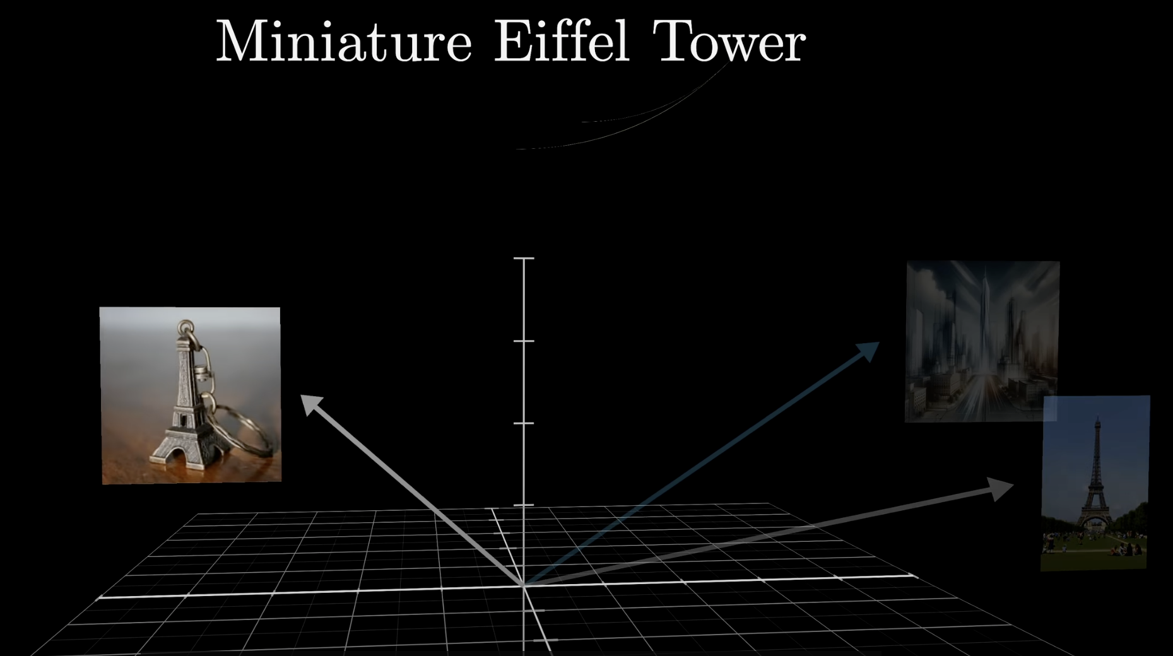
Notes:
Move the direction of the original encoding word to a direction defined by its context, and correct it.

Slide 24
5
4
Feed-Forward Network
3
Attention Mechanism
2
Positional Encoding (Adding Sense of Order)
1
Input Embedding (word into numbers)
Notes:
After the attention mechanism has created new, context-rich vectors for each word, they are sent up to the fourth floor for further processing. Here, each vector is passed independently through a standard, two-layer neural network.
This step serves two main purposes:
1. It adds more parameters to the model, so we are now increasing its overall learning capacity to model more complex relationships in language.
2. The second thing is that It introduces non-linearity (via activation functions), this gives the model more flexibility and power to learn difficult patterns that a purely linear system could not.
Think of this floor as a processing hub
where each word's newly contextualized vector
is refined and enhanced.

Slide 25
5
Linear & Softmax Layers
4
Feed-Forward Network
3
Attention Mechanism
2
Positional Encoding (Adding Sense of Order)
1
Input Embedding (word into numbers)
Notes:
After climbing through all four floors, we now have a final, highly enriched vector for each word in our input. Now it's time to make a prediction. This happens in two final steps:
1. Linear Transformation: This is a crucial expansion. This step takes the final, refined vector from Floor 4 (e.g., with 512 dimensions) and projects it across the model's entire known vocabulary, creating a much larger vector with a dimension for every single word (e.g., 200,000 words). The raw, unnormalized scores in this giant vector are called 'logits'.
2. Softmax Function: This mathematical function takes the huge vector of logits and transforms them into a probability distribution. The result is a percentage likelihood for every word in the vocabulary being the correct next word in the sequence.

Slide 26
5
Linear & Softmax Layers
4
Feed-Forward Network
3
Attention Mechanism
2
Positional Encoding (Adding Sense of Order)
1
Input Embedding (word into numbers)
Notes:
Scaling It Up: Multiple Floors and Heads
Our five-story building is just one block. The true power of models like GPT-3 comes from stacking these blocks on top of one another—up to 96 times. The output of one block becomes the input for the next, allowing for progressively more complex and abstract understanding. Furthermore, within each block's attention mechanism (Floor 3), the model runs multiple "attention heads" in parallel (GPT-3 uses 96), allowing it to focus on different linguistic relationships simultaneously.

Slide 27
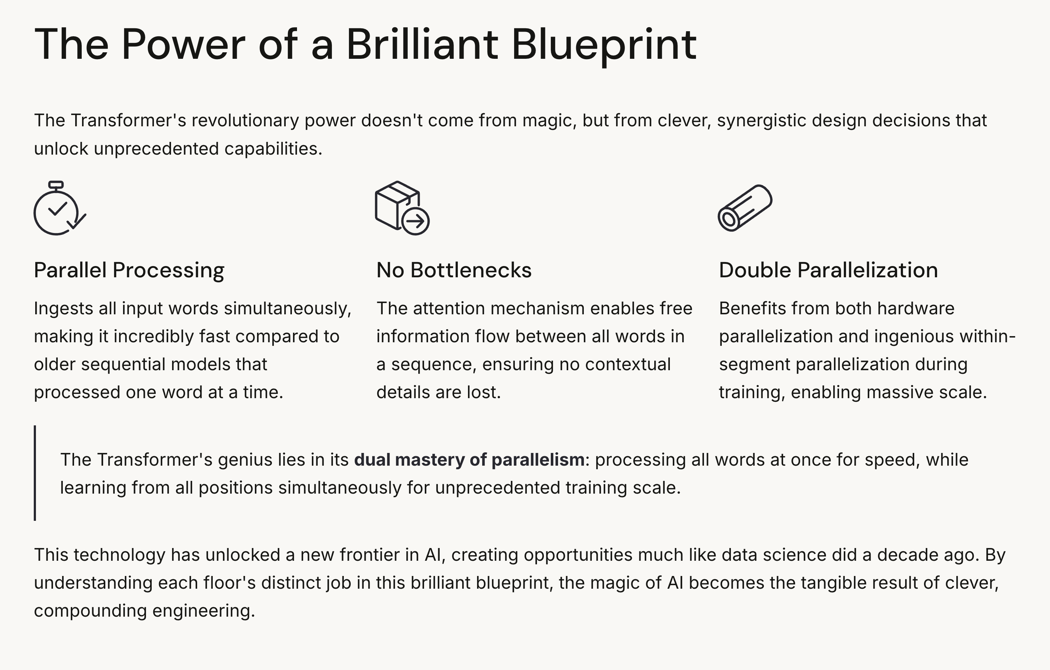

Slide 28
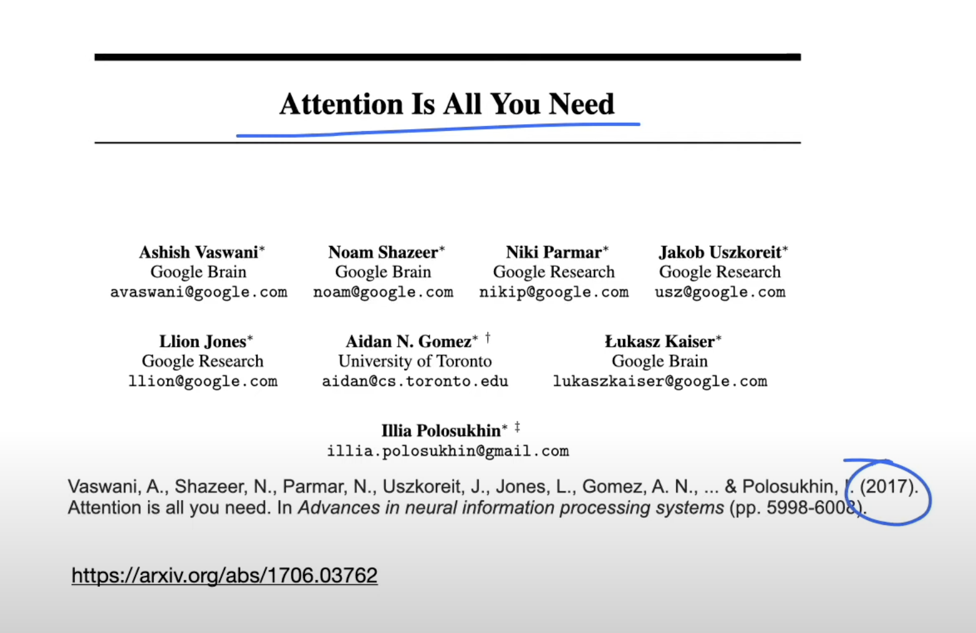

Slide 29
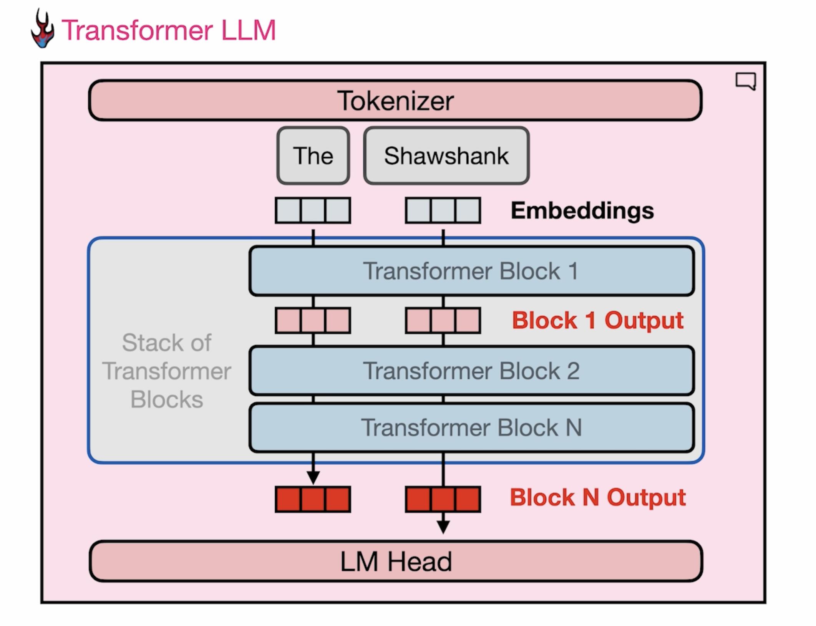
Notes:
To understand how Transformer blocks operate. Let's think about the two tracks that are flowing through the Transformer blocks. In the beginning, our tokeniser has broken down the words into these two embeddings.
So, The, has its own token, Shawshank, is the second token. And that is what we start calculating. Now we have turned language into numbers and apply a lot of interesting calculus on them to predict what the next word is.
So, those flow to the first transformer block, which generates a vector of the same size as its output.

Slide 30
Notes:
So, those flow to the first transformer block, which generates a vector of the same size as its output. And so, the same thing happens now with the second transform block that operates on the outputs of the first transformer block, in parallel across the various tracks. And this happens down the list of transforming blocks, all the way to the end, and then the final layer, this spectre, let's say, for the final token, in the prompt is presented to the language modelling head, which then outputs or generates the predicted next token. So this is the flow. So everything flows from the beginning, towards the end, one direction, from the tokeniser, down the transformal blocks, one by one, in sequence

Slide 31
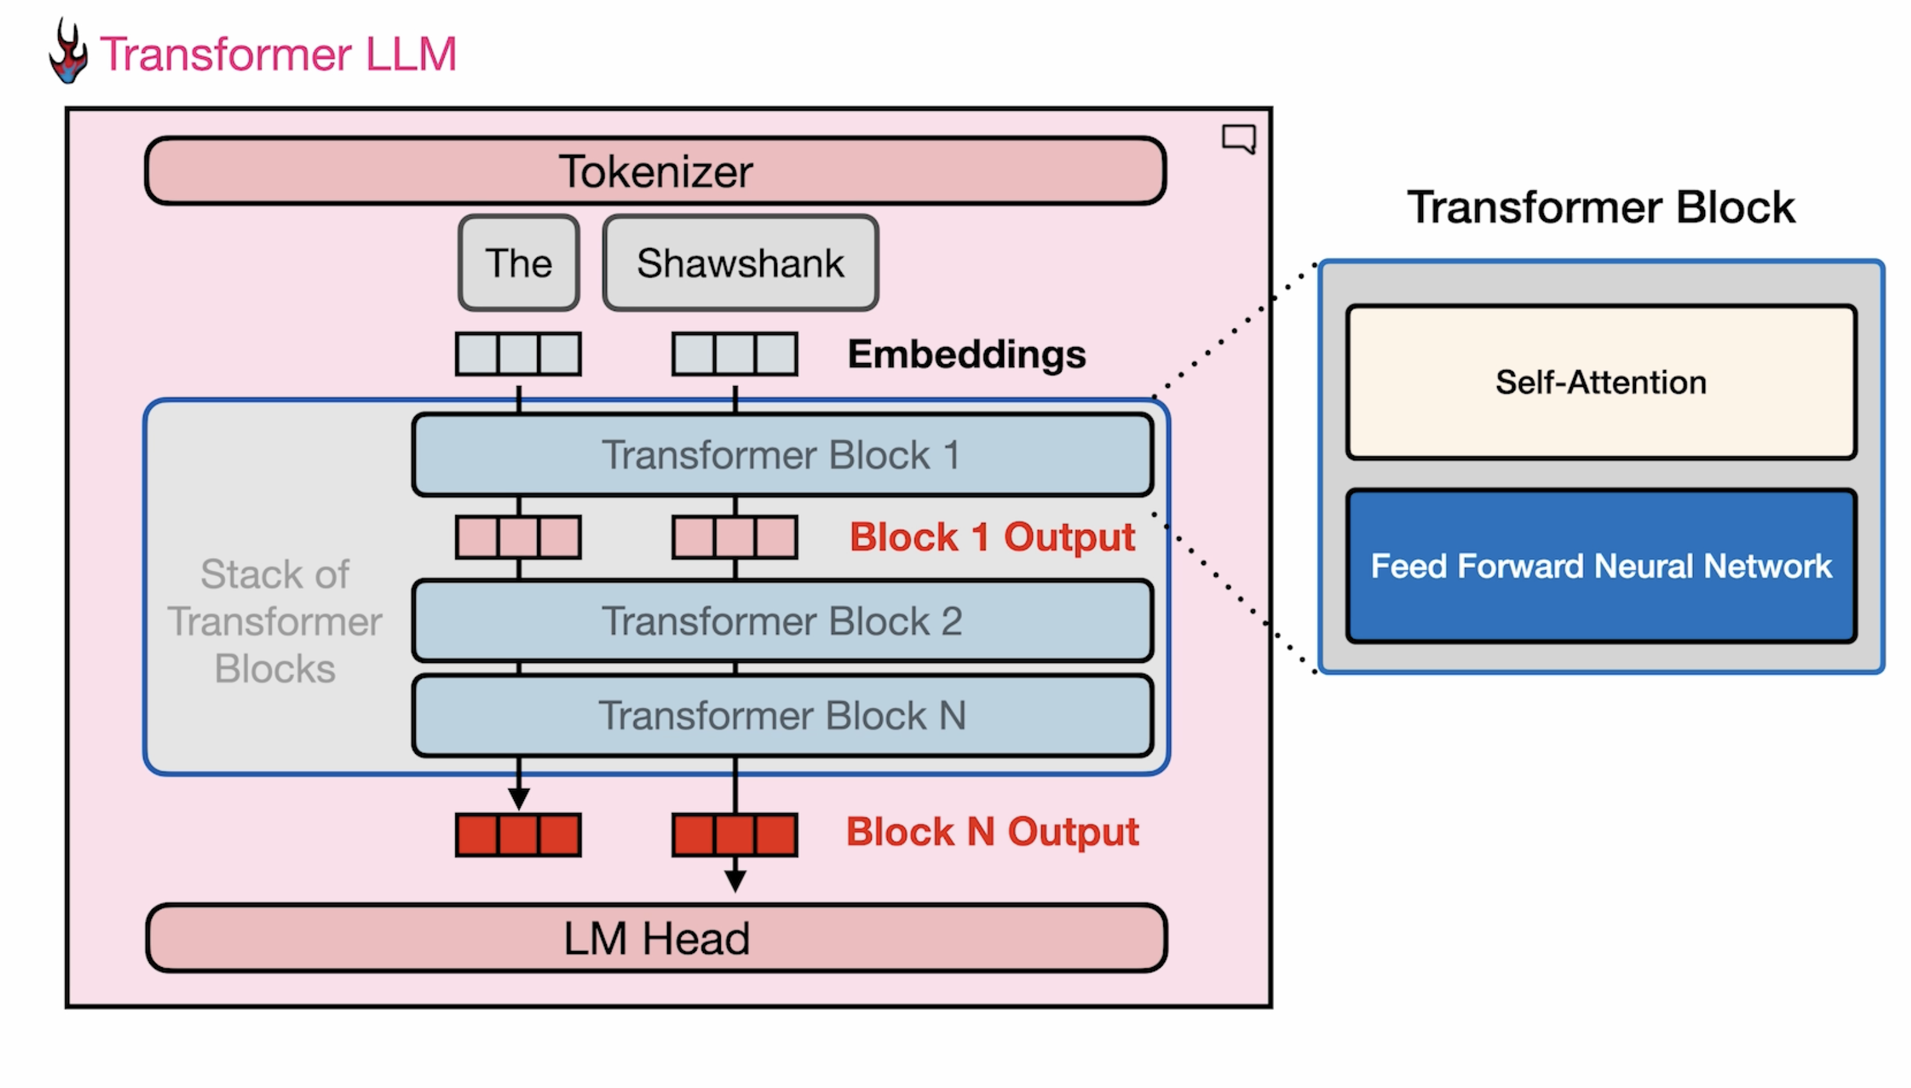
Notes:
Two main components in the transformer block:
the self intention, layer, and the feed forward neural.
The feed forward neural high level intuition: to say, the token that is most probable to come after this, and could be redemption. And so, this is in reference to the famous film, because if you look at the training, data set, if you get data from the internet, and Wikipedia, redemption would be the word that often, statistically, appears after... in most cases. This is one thing that the FeedForward Neural Network for neural network is able to do.

Slide 32
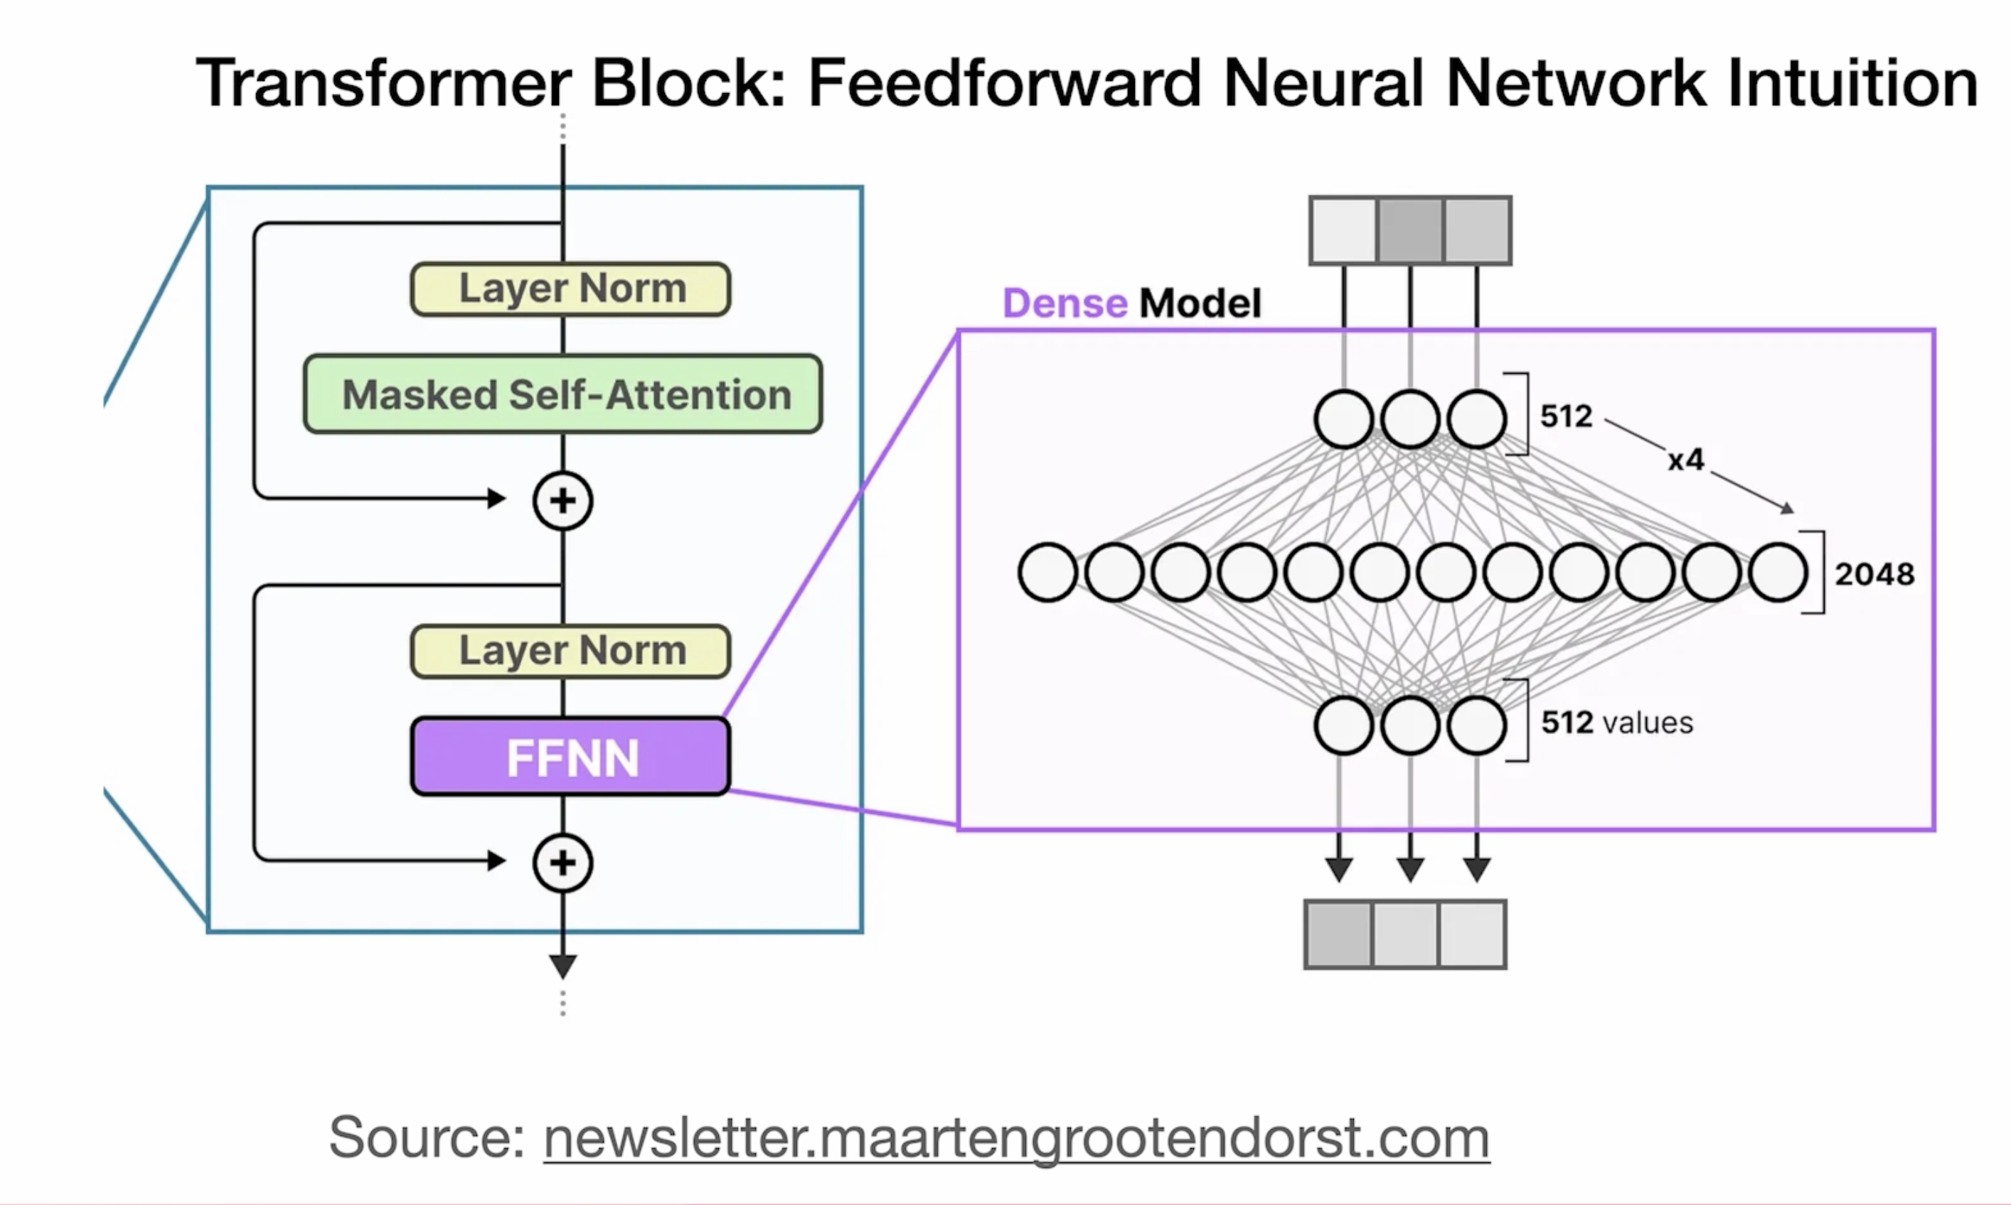

Slide 33
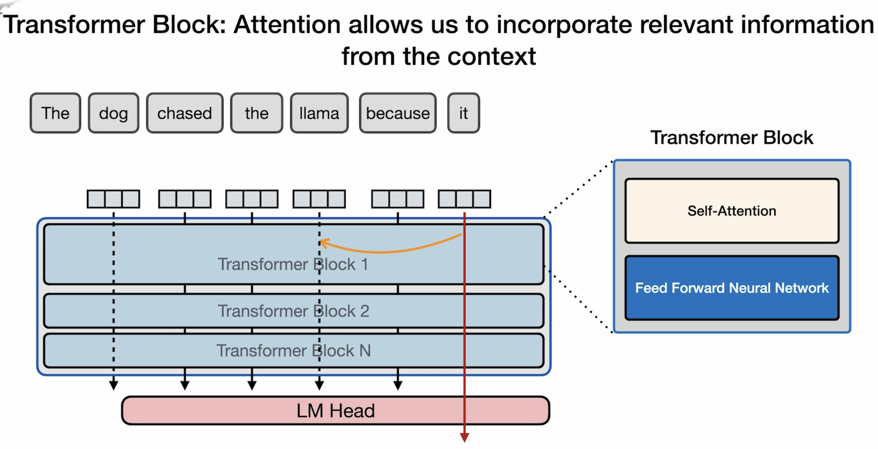
Notes:
Self attention, on the other hand, allows the model to attend to previous tokens and incorporate the context in its understanding of the token it's currently looking at. Let's look at this example. Let's say we have a prompt that is, the dog chased the llama because it, the model is processing the word, it needs to bake in some information about what does it refer to here? Is it the dog or is it the llama? It's important for the model to be able to have some sense of what that it refers to. And that's a little bit of what self-attention does.
It refers to Llama or dog?

Slide 34
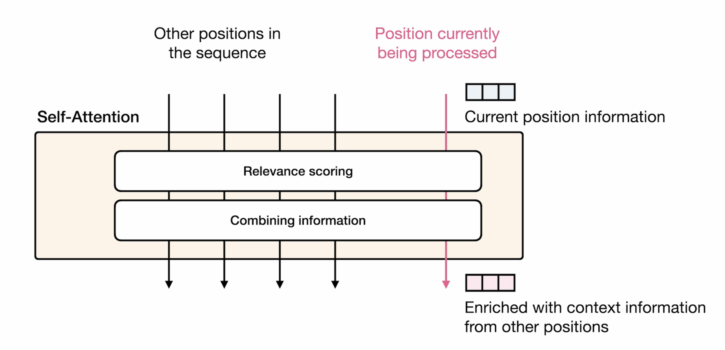
Notes:
So this is a high level formulation of self attention. get into more of the specifics in the next part, or what self-attention does is 2 things:
The first thing is relevance scoring, so it assigns a score to how relevant each of the input tokens are to the token we're currently processing.
And then the second step is after scoring that relevance, is combining the relevant information into the representation. So at a high level, this is what self attention boils down. Relevant scoring, and then combining information from the relevant tokens into the current factor that we're processing and representing.

Slide 35
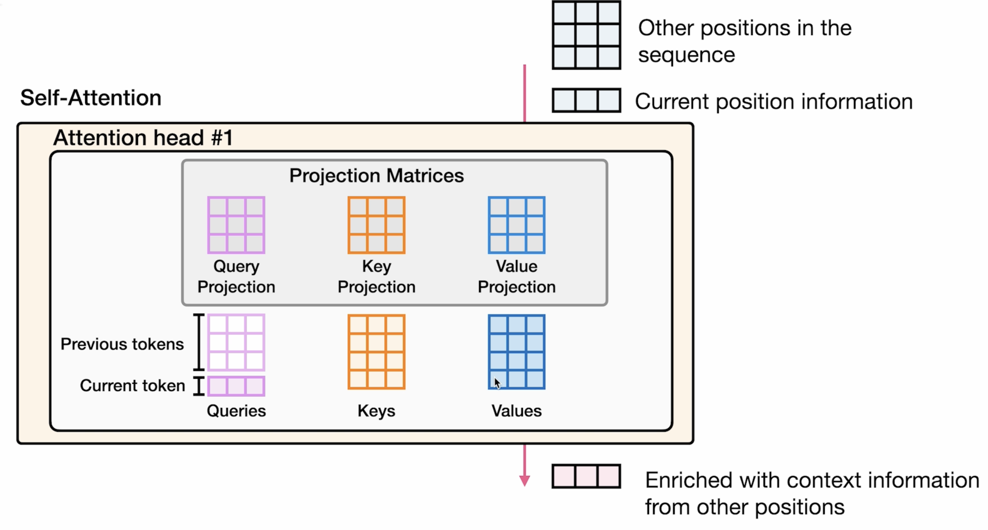
Notes:
Let's look at those more detail. Self attention happens within what you call an attention head. So let's assume we only have one of these attention heads, but now that we're using to process self attention. We have the token that we're currently processing, and then we have the other positions in the sequence. So these are the effective representations of the other tokens that precede this building. Self attention is conducted using three matrixes, the query projection matrix, the key projection matrix, and the value projection matrix.
For Transformers, the queries, keys, and values are important concepts. In this calculation, you get a sense of what each of them is used for. These weight matrices are used to calculate query, key, and value matrices. And through some interaction that we've discussed in the next coming slides, we can go about scoring the relevance and then combine the information. So, let's say, on the query side here, we have this query that represents the current position, and then just matrix, let's say, each row here represents one of the other tokens. And the same thing is done with keys and values, each row is a vector representing one position. It is. The end goal of relevant scoring is something like this. Every token that we have, any score assigned to them.
Jot something down

Slide 36
Notes:
we can go about scoring the relevance and then combine the information. So, let's say, on the query side here, we have this query that represents the current position, and then just matrix, let's say, each row here represents one of the other tokens. And the same thing is done with keys and values, each row is a vector representing one position.

Slide 37
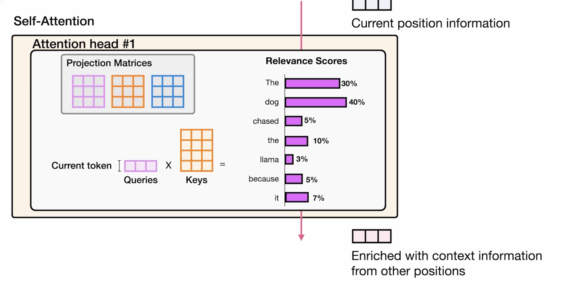
Notes:
The end goal of relevant scoring is something like this. Every element that we have, any score assigned to them, this telling us how relevant this token is to the token we're currently representing.
In this case, let's say we have the dog that has the highest relevance scoring, and so, the representations of the tokens of the dog will be baked into the enriched vector here towards the end. But this is the end of relevance scoring, giving us these scores, and they add up to 100.
Now, technically, how this is done is by matrix multiplication, we multiply the queries, vector, associated with the current token by the keys, vectors, that represent all the previous tokens. This is a high level intuition.

Slide 38
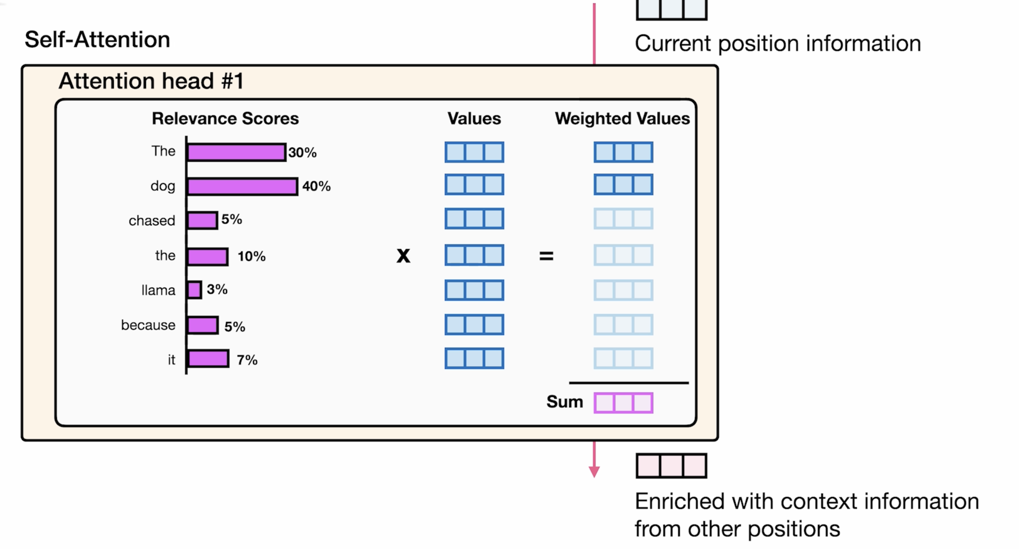

Slide 39
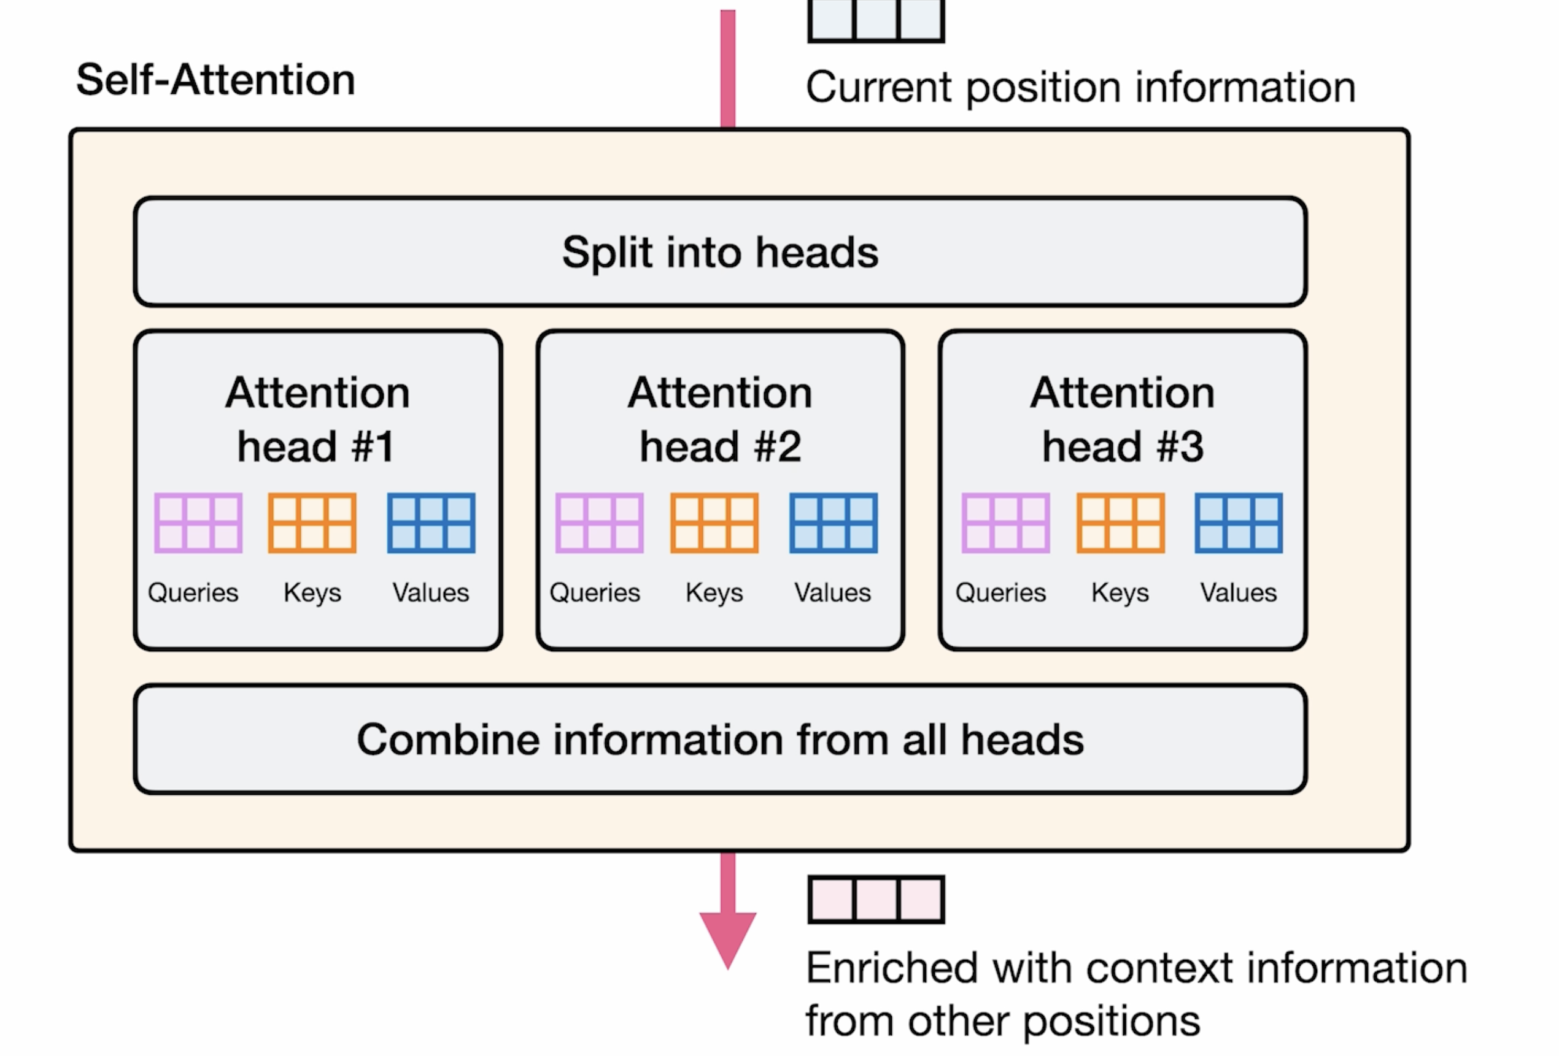

Slide 40
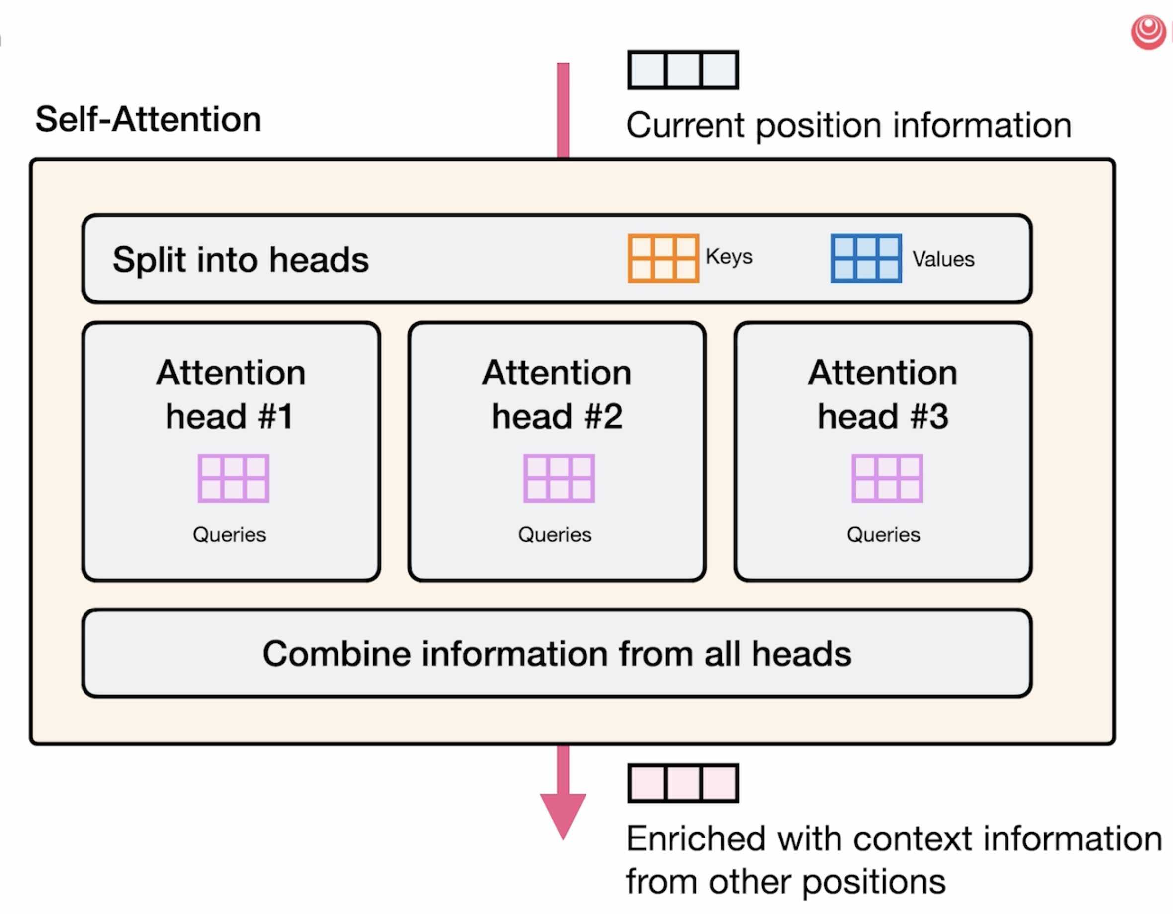

Slide 41
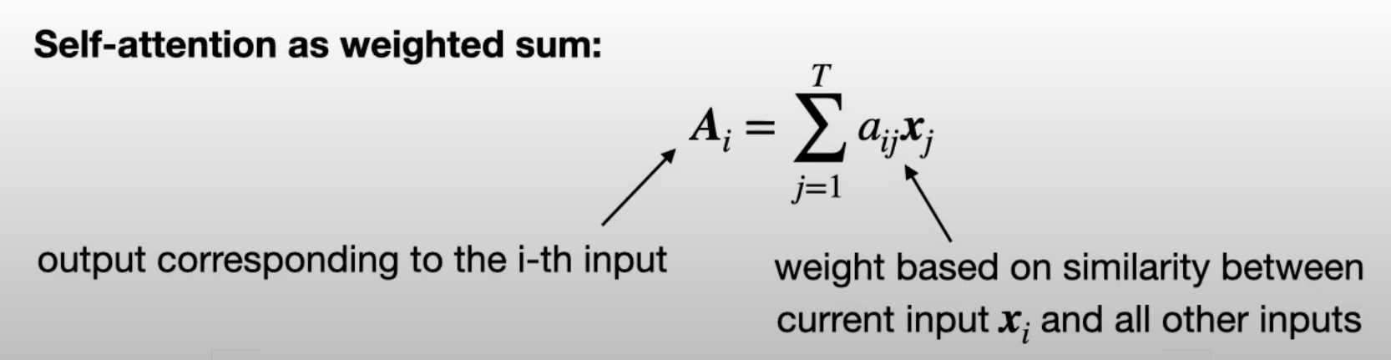
Self Attention Mechanism -- Very Basic Form
Main Procedure
Derive attention weights: similarity between current input and all the other inputs
Normalize wights via softmax
Compute attention value from normalized weights and corresponding inputs

Slide 42
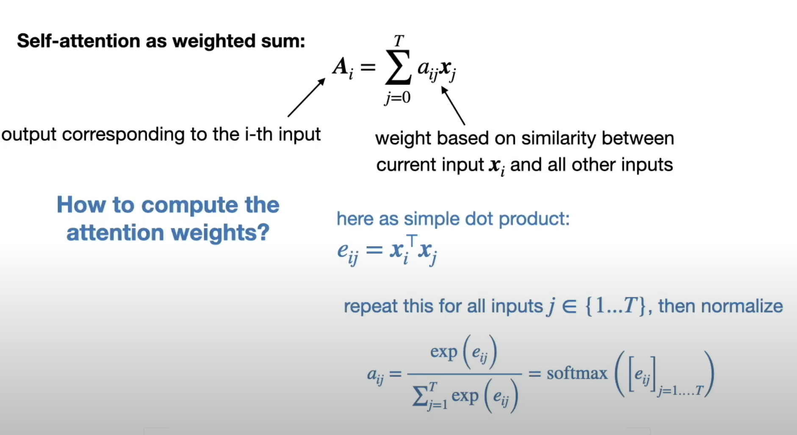
Self Attention Mechanism -- Very Basic Form
Notes:
To compute the attention weights → assume the attention weights I compute as the dot product between word_i and word_j → then you compute the normalize suim, this will be the attention weights.

Slide 43
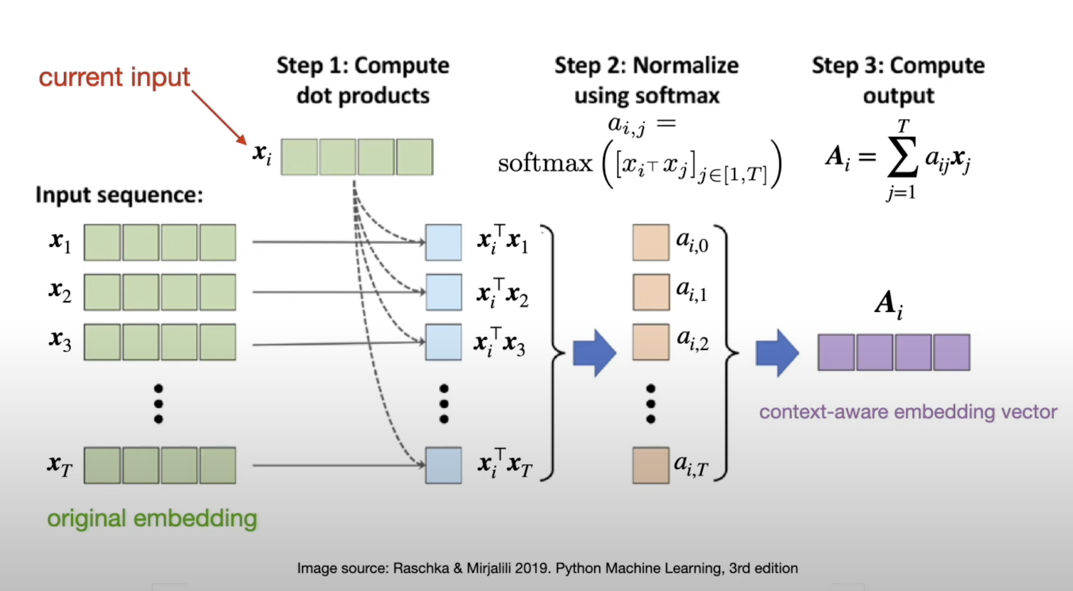
Self Attention Mechanism -- Very Basic Form
Notes:
Visual representation of previous page:
Dot product one way to compute similarity but consider other ways like cosine.
Vector is like a word enmbeeding but this time we added information about context.
Each word is always the same if is green in the initial embedding, however, now that we add the attention we make it aware of its context.
This is a simple tway to understand self attention but in the paper they did it more complex solution.

Slide 44
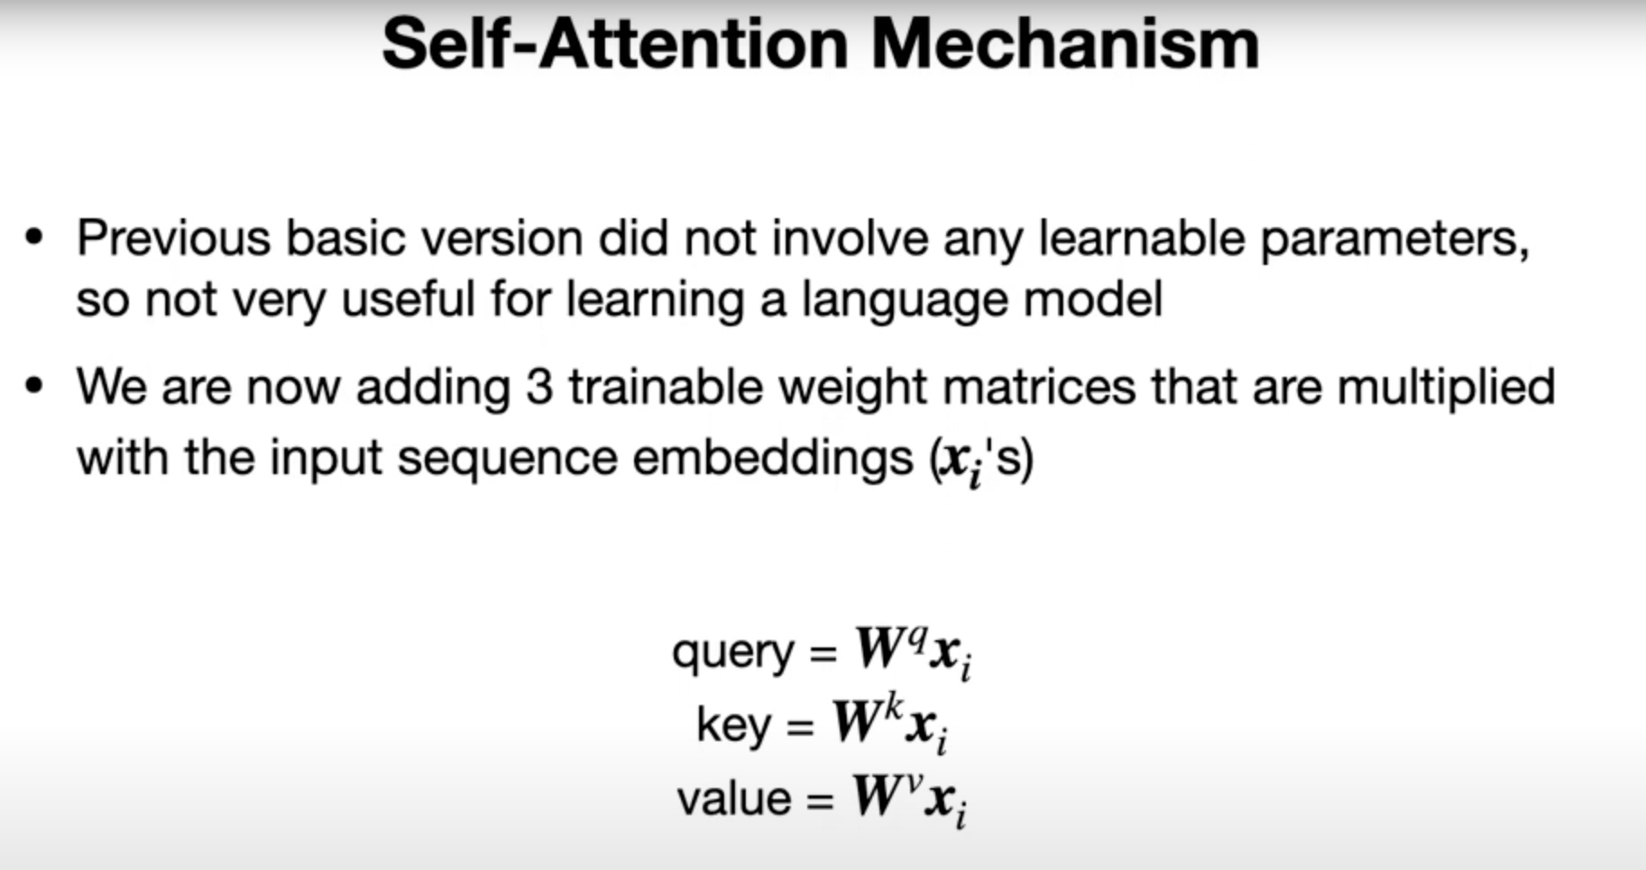

Slide 45
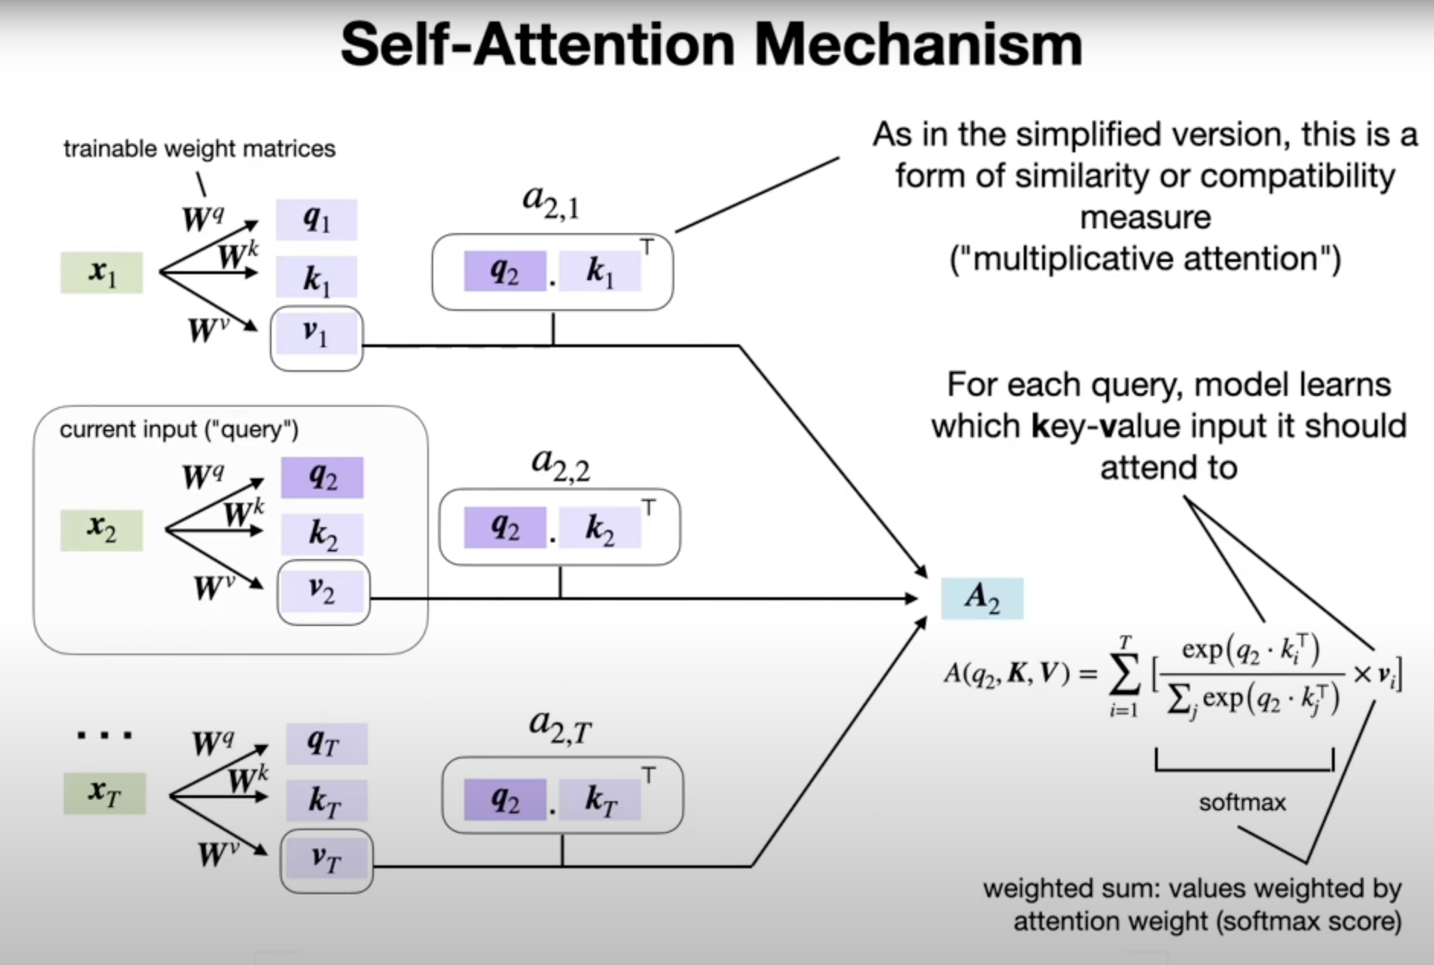
Notes:
Weights are computed between the query and the key.
Terms query, key and value → comes from the field of data bases (not really important)
Dot product is know as multiplicative attention.
For each query, the model learns which key value input it should attend to.
Similar to before, but computation is a bit fansier.
More notes: So here's the drawing of how this self attention mechanism looks like for a particular input, so it's considered the one in the middle here, X2, work the second word in the sentence. So we consider this as the current input.
It's just a matrix modification to compute these three things. And we do this actually for all the inputs.. So from word one, two, up to the last word. Now, we are also computing the attention values here as a dot product. However, here we are now computing it instead of computing in between the sequences, X, 1, and X, let's say, I, sort of computing it like this. We compute it, actually, between... the query and the key. So these are just modified versions of that. So here, we are regarding Q2, as the current inputs, so we are using Q2 here everywhere. This is our query. And then we use the key, so maybe we use different colours. So for the blue one here, use blue key for the green one here for itself. We use green one. And for this one, we use this one. But this... aquarius is all the same. The keys are different, but the queries are the same. So why the terms query key in value, this, I think, comes from the field of databases. So it's not really that relevant. It's just different. Yeah, different names for different parts of this computation here. And you can, you know, think of this. This is also known as the stock product here is multiplicative attention. There's also there are other types of attention like additive attention. But here it's like a form of, yeah, a form of multiplicative attention, and essentially, for each query, for each here, for each query, the model learns which key value input it should attend to. So, continuing with this model here, when we computed these, there's also a normalisation via the soft mix, and then these are added up to form this A2, which is the context where embedding of the input. So if I go back, This is similar, essentially, to what happens here. Right? So when we have our context where embedding of the input X i, now we have the same thing, except the computation is a little bit fancier because we involve these three matrices. I will also show you, I mean, there's also a scaled version of that, but one step at a time, so here is the not scaled version. So here, in the centre, we have, again, a soft mix.

Slide 46
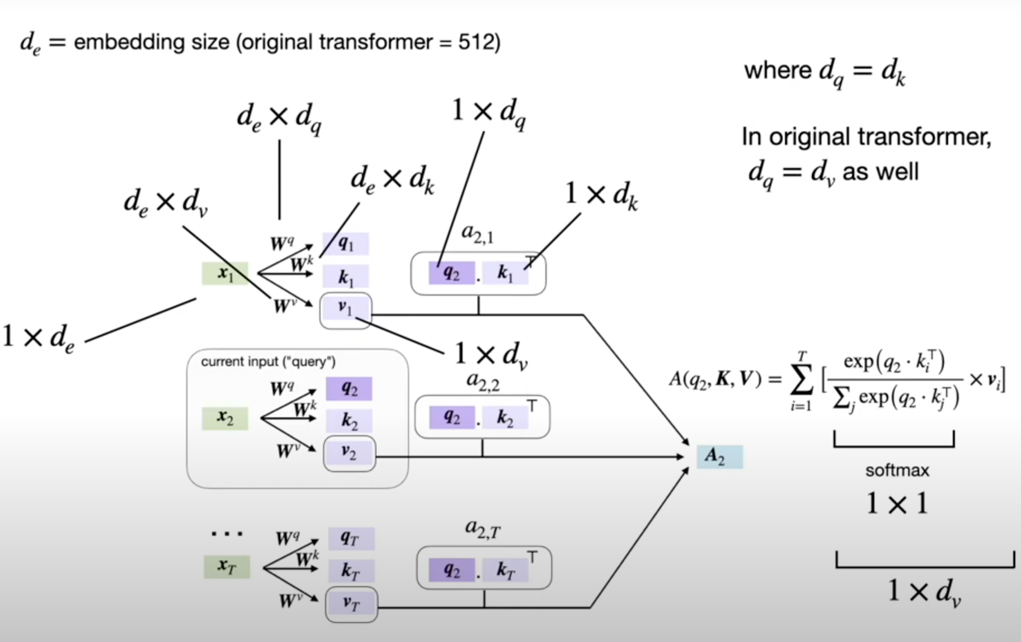
Notes:
I made a copy of the previous slide and added some annotation about the different dimensions of the different parts in that sphere. So let's walk through this from left to right. So, here, X ain, the X one. This is a word we're getting back to, so you can think of it as a one times the E dimensional matrix or TE dimensional pictum, where the E is, yeah, the embedding size and the original attention small, you need paper, they used 512 as the embedding size, but of course, this is hyperpermeter, something you can choose. It's arbitrary in that way. Can have 256 or 1024 or some other number is the word embedding size, as we have seen also when we work with RNNs. Then we have our matrices here, W's, the query key and value, and they have to have, of course, the same dimension, I mean, the same number of rows as we have columns here for the matrix modification. So we have the E everywhere, and then the output size, the number of columns is TV, DQ, and DK. And in the original paper, they had DQ equalling DK. I mean, of course, that's also necessary for the stock product here, right? You have to match the dimensions. And in the original transform paper, they also had DQ equal to DV. So, um, this is, we'll see later why that is, it's because we have also, um, yeah, certain stacking going on and things like that. So that's determining our output size. Okay, um, what else? Yeah, so this will be, of course, scalas, these stock products, right? Because it's a modification between 2 vectors. So on soft mix here, this will give us our, essentially, our scaled attention rate that we then multiply by this value vector, which is a one times TV dimensional vector, and then we sum that up. So the output size of this one would be one times DV. So that's, yeah, just annotated what these ports are, know you, know what is the vector and what's the matrix, that wasn't clear before, but yeah, this is, I think, maybe just another summary of the previous slide.

Slide 47
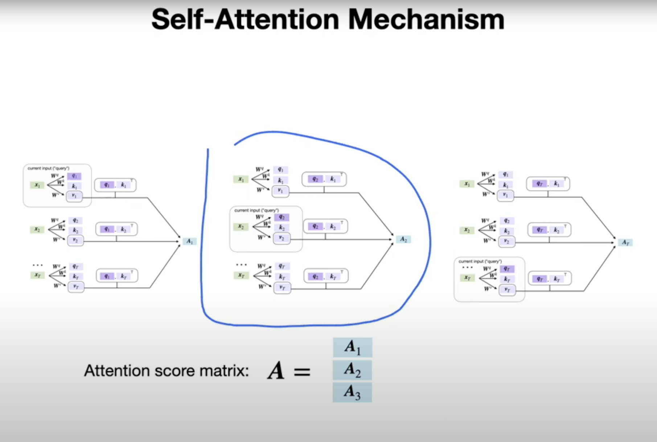
Notes:
So, again, this one here is just for one word, right? So this is just for 2nd word, so it's attention vector for the 2nd word. So the previous slide we had looked at the 2nd word as the input, but of course, we have also other words in the input. So we would repeat this whole process for every input element. So here on the left-hand side, consider the 1st word, and here on the right hand side, we consider the last word, whereas here we consider the 2nd word. But this might be a misleading visualisation. It looks like there's a sequential part to it. That's not true. All of these can be computed in parallel. We don't have to wait for one to finish before we can compute the next. So these are all parallel computations, which is one nice aspect about these transformer models or the self attention mechanism in the transformer model. And then, so we get an attention aware embedding for each of the words, and then these essentially, you can think of it as a matrix, no, an attention matrix. where each row corresponds to, yeah, to the embedding attention abetting for each word. So it should, if we have a tea here, this would actually be a team. Okay, um, yeah, here's just like, uh, one a compact notation for that.

Slide 48
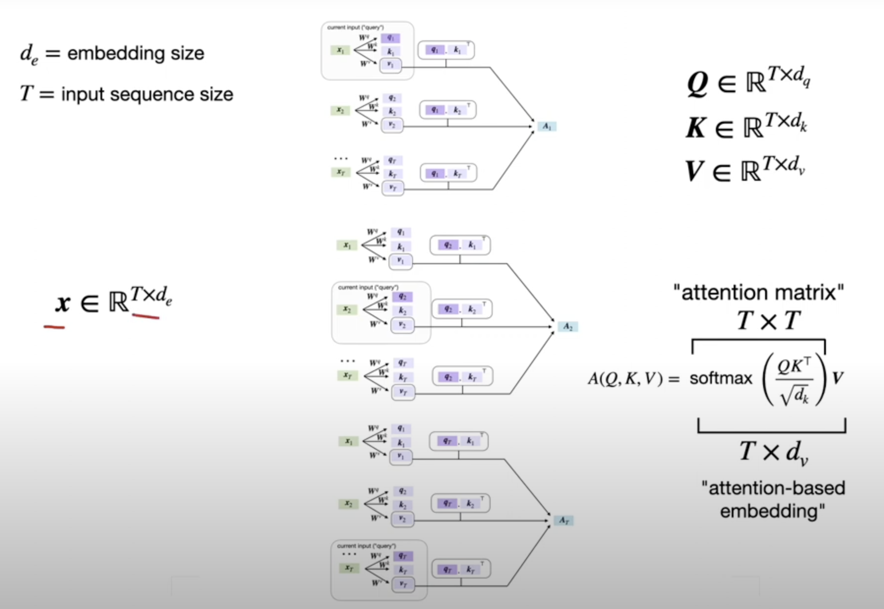
Notes:
So I'm just summarising everything here in the centre. So now, instead of doing these steps individually here, can just write this as one matrix multiplication. So, we now have, let's say, the matrix cube. So we instead of having Q one year, Q one, Q one, and so forth. So these results we can just summarise that as a matrix, a T times DQ dimensional matrix, K times T times DK and T times DB. And then we can compute this attention matrix, which is a T times T dimensional matrix. So this is one, maybe one disadvantage of the self-attention approach is that this is kind of large, if you have a large input sequence, because yeah, it's like a pairwise in a way pairwise, uh, similarity score here. So it's and squared, uh, sport T squared, uh, the big O of that. So it's not the most, I would say, memory efficient approach, but, well, at least we can compute things in parallel. So, we have now kindly kind of slightly modified version of the top product that I showed you before. We call that the scale to start product, which is because of this one, I will explain that at the next slide. Just focussing, again, on this whole thing here. So now we have Q times K, as a matrix modification. Then we take the soft max. So we have Q times T, Q times K as the matrix modification, and we have this scaling here. And we'll talk about it in the next set. And then we have the soft mix, and then we multiply by the matrix V. So this is just a more compact form of what I've shown you on the previous lines. And then we will get this T times TV, uh, dimensional attention matrix. Okay

Slide 49
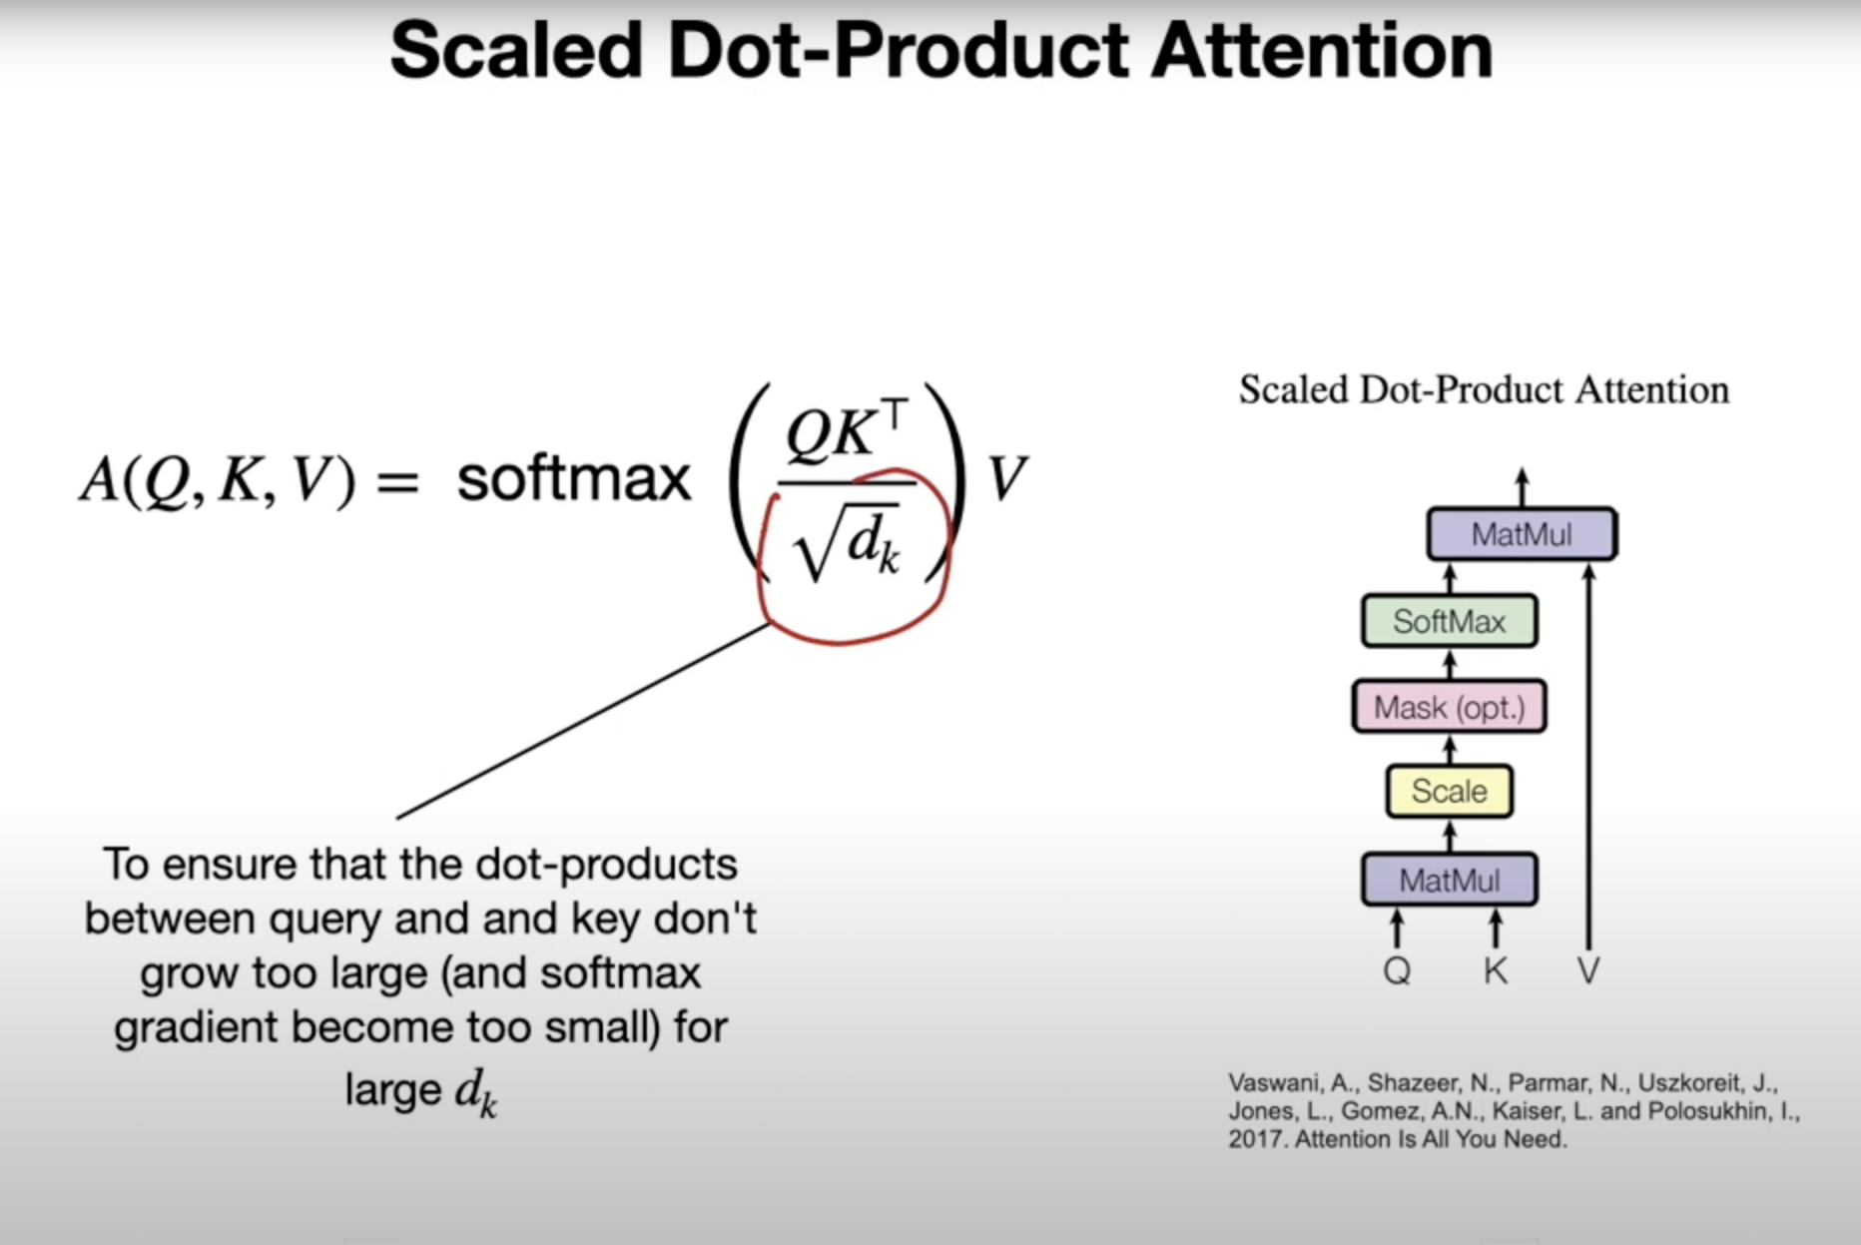
Notes:
Okay. So what is this scaling factor here in the denominator? So this is just to prevent these individual dog products. So if you do a matrix modification, you can also think of it as multiple dot products, between these Q and Ks. So, to prevent these 2 become too large, we scale them because if you think of the soft mix function, if you have a very negative input to the soft mix function, it will be 0. If you have a very large input, a very positive, large input, it will be close to 1 in the soft mix. So, in order to prevent a very sharp distribution of values in the soft max, we have this scaling factor, because if you maybe just think back off the logistic sigmoid, which is essentially similar to the soft max, except that soft mix incorporates all the other ones. But it's kind of like a sigmoidal thing if you have well is close to one, close to 0, it's like this situation, right? So you want to prevent values from being too extreme. I mean, the same concept, this is, of course, not a soft mix, but the same concept applies to the soft max. So by scaling, we prevent the soft mix from having a distribution
Yeah, and here, just for a reference, is the visualisation of the scale dot product attention from the attention is all you need paper. So again, they are just summarising summarising that visually, the matrix modification, and the scaling gear. Um, optional mask, um, we will talk about the mask later when we talk about the transformer. Here in these steps, there is no masks. So the transformer also consists of an encoder and a decoder and a decoder has a mask. So here, it can actually ignore it.that is too sharp.

Slide 50
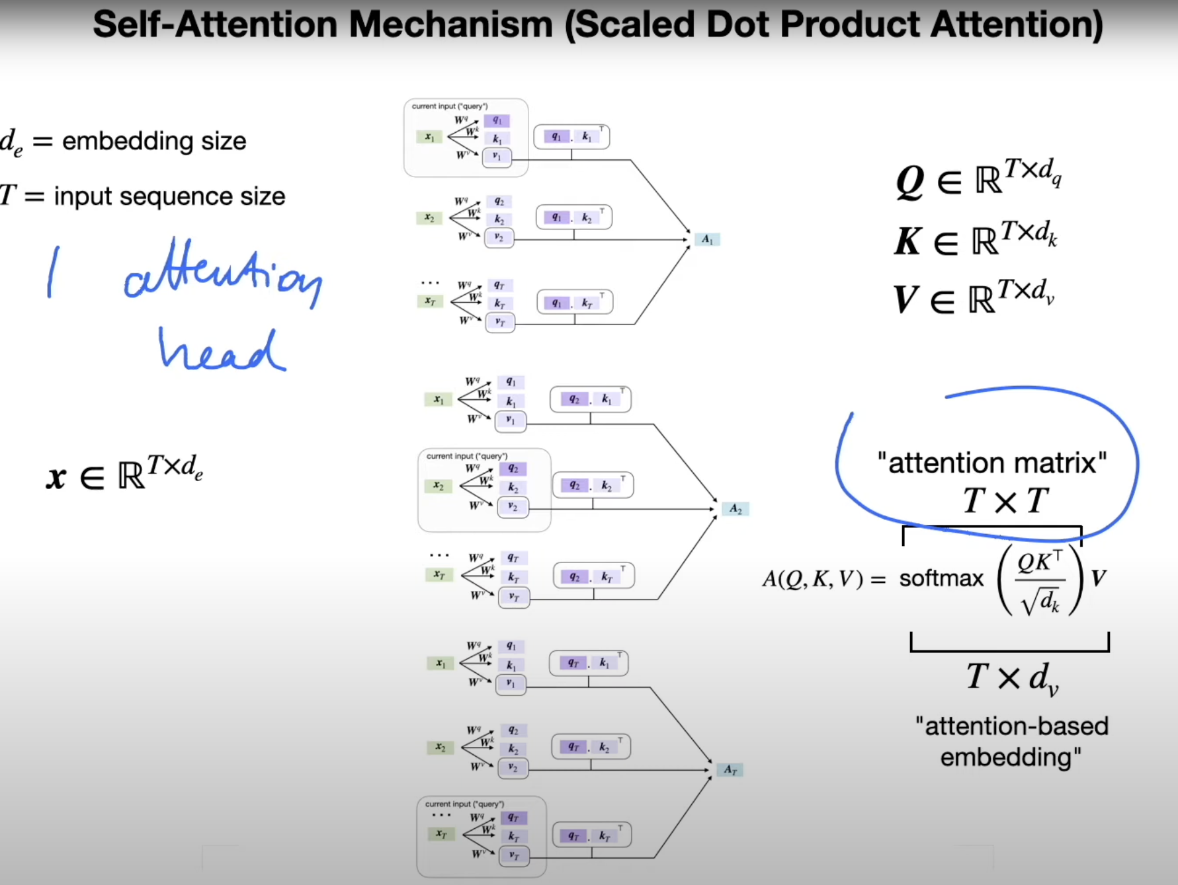
Notes:
Testing. Let's rest on our laurels and just extend this multiple times, which we will call multihead attention. So it's also part of the transformer model, which we will eventually get to.
So, for now, let's focus on the multihead attention, though. So, in the previous video, I showed you this, where we computed this attention matrix, and we can think of this as one attention head. And, yeah, surprise, surprise.
Multi had attention is this thing here, just multiple times. Using different weight matrices.

Slide 51
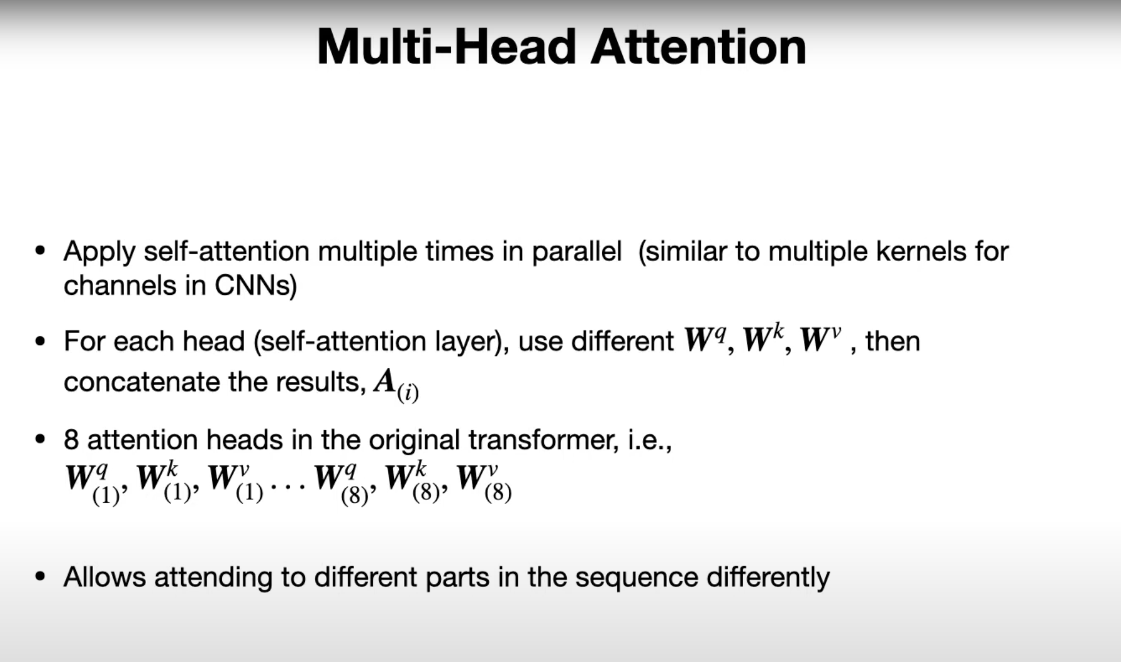
Notes:
So to summarise, we are now going to apply self attention multiple times in parallel, similar to how we use multiple kernels for the different channels in the CNNs.
So, remember, when we talked about CNNs, we had, for instance, input image with three colour channels, and we went from three channels to 64 channels, for example. For that, we used 64 kernels in parallel. These would be, for example, 3 by 3 by 3 kernels, and we had 64 of those.
So in a similar manner, we can also use multiple of these processes here, these multiple attention heads. I am not sure where it's called, head, but let's just use the original terminology. We can use multiple of these attention heads to compute things in parallel, and yet to attend different parts of the sequence differently.
So for each head, we use different weight matrices. So we had three weight matrices for the quarry, the key, and the value. And we will use different one snow, and then we will concatenate those, the results of those.
So it would be more clear in the next slide, I guess. So in the original attention is all unique paper, they had 8 attention hits. So, essentially, they had eight times three matrices, so each attention had had a set of the quarry, key and value matrix, and we had eight of those sets.
And this allows the model to attend to different parts in the sequence differently for each head. And similar to the concept behind colour channels, essentially. Or output channels.

Slide 52
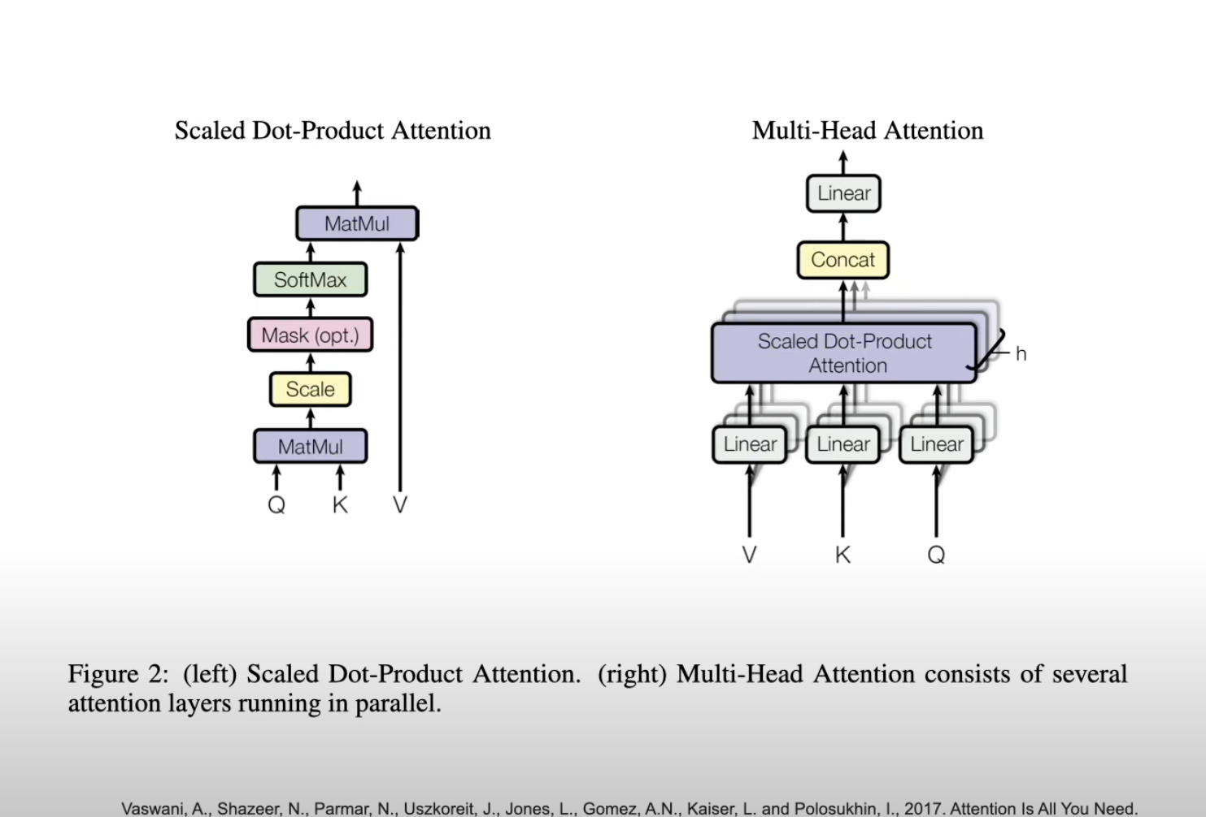
Notes:
Okay, so, again, so this is our scaled dot product attention that we talked about. That's essentially this. And here is the multi-head attention.
That's just a screenshot from the original paper, and you can kind of guess what's going on here. So here, the centre, is the scaled product tension. It's essentially this one summarised.
But you can see, this is just steak. So you have a stacking here. So you repeat this eight times, whereas in the original paper, they end this eight times.
So the linear corresponds, my guess, to the matrix certification. Between the weight matrices and the inputs.

Slide 53
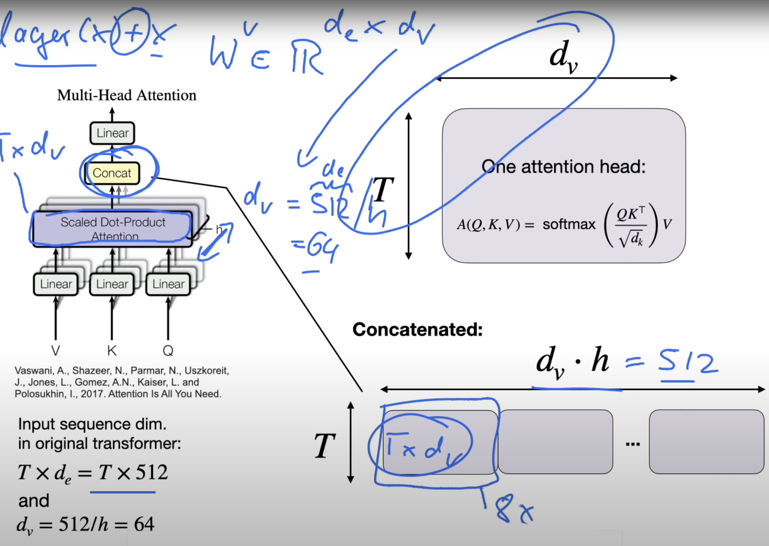
Notes:
Yeah, the input sequences, T times 500 12 dimensional, like we talked before. And in the transformer model that we will be talking about in the next video, they use 512 for the input embedding size. And for the value size, so when we have the weight matrix, sorry?
TV. So we will have the dimensionality of that would be 8 times... TV, where DV is 512.
So, this is TE divided by H. That's the number of attention heads. So this is 64.
And this is such that when you multiply it by the number of attention heads, you get the input and input embedding size back. And that is useful when you want to use something like skip connections, and you have a skip connection, it's like, if you remember, like this, so you have a layer x plus x, the input. So you have to have the same dimension, otherwise the addition doesn't work.
Okay. So, the concatenation here is we have done the scaled product attention. If I go back here, the scaled product attention is T times DV dimensional.
Right? It's one scaled stock product attention. So it's one, one of these here, is T times DB dimensional.
So, one of these, essentially, two turns into people. Now we have eight of them, right? So we took it as H times, for instance, in the original paper, 8 times.
And then, we concatenate, so that we will get this. This here, eight times, so we will get, oh, eight times. So we will get DV times H, and if DV is 64, we will get 512 dimensional input back here.
So again, one, one attention head is T times TV. We concatenate and get this T times 500 to 12 here in this concatenation step. So that's essentially what's going on in the multihead attention.
We repeat this multiple times, this scale to product attention, each time with different weight matrices, and then we concatenate the results.

Slide 54
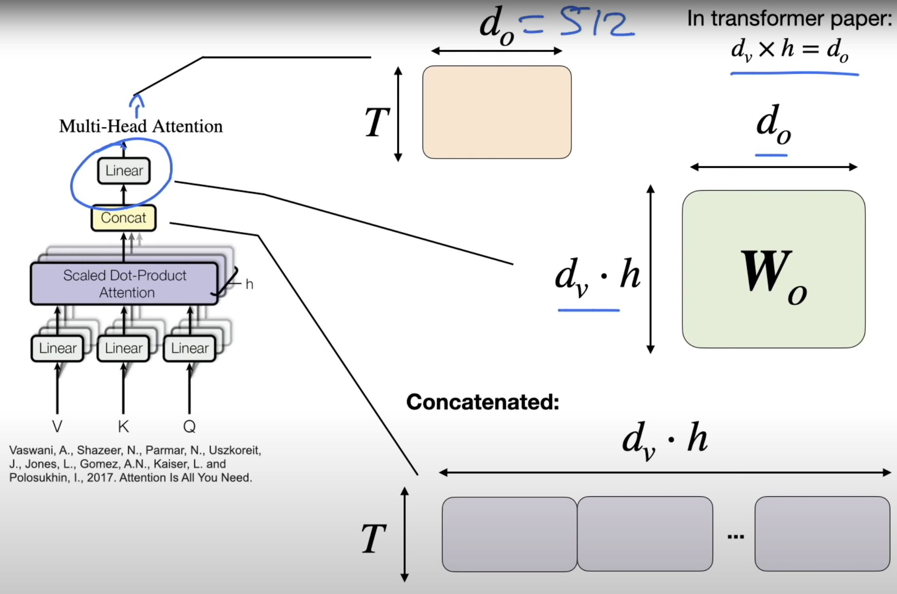
Notes:
A few more things. So there's another matrix involved here.
So you can see there's this linear matrix. So, this linear matrix, it's just to provide more parameters for learning, for instance. So, we have the concatenation, and this matrix is TV times H dimensional, and then we have an output dimension, and the output dimension is equal to, so the rose, and the column is the same number.
So it's a quadratic matrix. So the output would be also 512 here. Okay, and this is it for multihead attention.
Pretty simple concept. It's essentially just applying the scaled dog product attention mechanism multiple times in parallel, concatenating the results, putting it through another fully connected layer. And yeah, that's it.

Slide 55
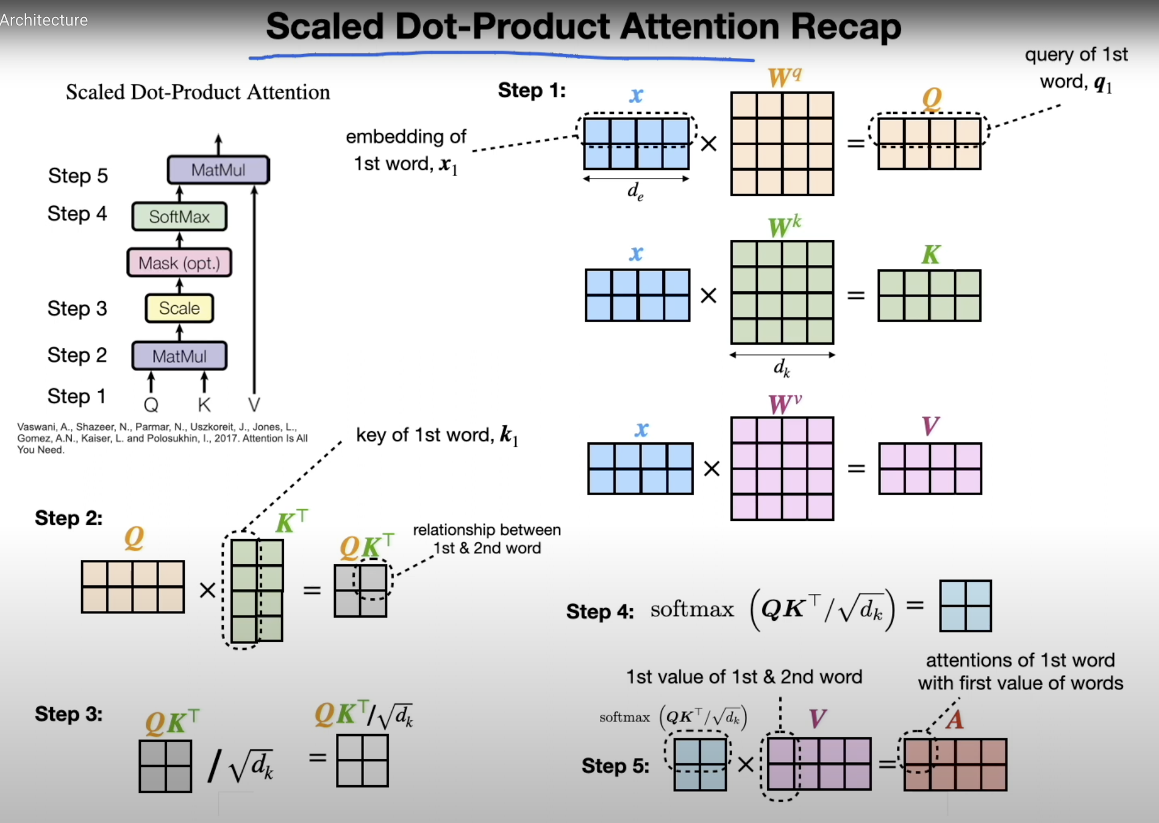
Notes:
Testing. Let's rest on all laurels and just extend this multiple times, which we will call multi-head attention. So it's also part of the transformer model, which we will eventually get to.
So for now, let's focus on the multihead attention, though. So in the previous video, I showed you this, where we computed this attention matrix. And we can think of this as one... head.
And, yeah, surprise, surprise. Multi had attention. This thing here, just multiple times, using, yeah, different weight matrices.
So to summarise, we are now going to apply self attention multiple times in parallel, similar to how we use multiple kernels for the different channels in the CNNs. So remember, when we talked about CNNs, we had, for instance, input image with three colour channels, and we went from three channels to 64 channels, for example. So for that, we used 64 kernels in parallel.
These would be, for example, 3 by 3 by 3 kernels, and we had 64 of those. So in a similar manner, we can also use multiple of these processes here, these multiple attention heads. I am not sure where it's called head, but let's just use the original terminology.
We can use multiple of these attention heads to compute things in parallel, and yet to attend different parts of the sequence differently. So for each head, we use different weight matrices. So we have three weight matrices, for the query, the key, and the value, and we will use different ones now, and then we will concatenate those results of those.
So it will be more clear in the next slide, I guess. So in the original, attention is all unique paper, they had 8 attention hits. So, essentially, they had eight times three matrices, so, each attention had had a set of the quarry, key and value matrix, and we had eight of those sets.
And this allows the model to attend to different parts in the sequence differently for each head. It's similar to the concept behind colour channels, essentially. Or output channels.
Okay, so, again, so this is our scaled dot product attention that we talked about, that's essentially this. And here is the multi-head attention. That's just a screenshot from the original paper, and you can kind of guess what's going on here.
So here, the centre, is the scaled dot product attention. essentially this one summarised. But you can see. This is just stacked.
So you have a stacking here. So you repeat this age times, whereas in the original paper, the endless age times. So the linear, um, corresponds, my guess, to the matrix signification, between the weight matrices and the inputs.
Okay, um... Yeah, the input sequence is, T times 500 12 dimensional, like we talked before, and in the transformal model that we will be talking about in the next video, they use 512 for the input embedding size, and for the value size, so when we have the weight matrix, um, Sorry, TV. So we will have the dimensionality of that would be...
TV, or TV, is 512. So, this is, divided by H. That's the number of attention heads.
So this is 64. And This is such that when you multiply it by the number of attention heads, you get the input embedding size back. And that is useful when you want to use something like skip connections and you have a skip connection.
It's like, if you remember, like this, so you have a layer X plus X the input. So you have to have the same dimension. Otherwise, the addition doesn't work.
Okay. So the concatenation here is we have done the scaled product attention, if I go back here. The scared, not product, attention is T times DV dimensional, right?
It's one scaled product attention. So it's one of these here is T times DB dimensional. So, one of these, essentially, two times.
Now we have eight of them, right? So we, to get this H times, for instance, in the original paper, 8 times. And then we concatenate.
So what we will get is, this here, eight times, so we will get, well, eight times. So we will get DV times H, and if DV is 64, we will get 512 dimensional input back here. So again, one, one attention head is T times TV.
We concatenate, and get this T times 512 here in this concatenation step. So that's essentially what's going on in the multihead attention. We repeat this multiple times the scale to product attention, each time with different weight matrices, and then we concatenate the results.
A few more things. So there's another matrix involved here. So you can see there's this linear matrix.
So this linear matrix. It's just to provide more parameters for learning, for instance. So we have the concatenation, and this matrix is TB times H dimension, and then we have an output dimension, and the output dimension is equal to, so the rose, and the columns is the same number.
So it's a quadratic matrix. So the output would be also 50012 here. Okay, and this is it for multi-head attention.
Pretty simple concept. It's essentially just applying the scales. product attention mechanism multiple times in parallel, compatenating the results, putting it through another fully connected layer, and yeah, that's it. So, and now, we have talked about all these concepts, but we haven't learned it how they fit together into all...
It was a basic form of self attention for introductory purposes. Yeah, so in the previous three videos, we laid the groundwork for understanding how the transformer model in the attention is all you need, paperwork. So we started with a basic form of self attention for introductory purposes, and then we discussed the scaled dot product attention found in the attention is all you need paper.
And then we talked about multihead attention that is running multiple of these scaled dot product intensions in parallel. And these are all components of the transformer mode of the original. Vanilla.
Transformer model, which is found in the attention is all unique paper. And in this video, we will go over, yeah, the architecture, a little bit in more detail how the architecture of the transformer looks like. But before we get to the transformer, let me just briefly recap the scaled dot product attention, because it's part of the transformer, and so that we have it fresh in our memory, and the second reason is because it's spent so much time making this slide.
I would at least like to talk about it for a little bit, so it was not all for nothing. All right? So, on the left hand side here, that is just a summary of the scared toroical tension, from the original attention is all you need paper.
I structured it into five steps here, so that we can talk about step by step. So step one is constructing the queries, the keys, and the values. So imagine you have an input, X, which the rows are the different words, so let's say the first row is word one.
The second row is word two. Of course, in the real data case, you have many more words, but so that I can fit everything under the slide. We keep the example here small.
And then the columns is that I'm in, the bedding size here. The word emitting size. We multiply it by a matrix WQ, that is a matrix that is, yeah, updated during big propagation, and this produces the queries.
So still, the 1st row corresponds to word one, and the 2nd row corresponds to word two. We repeat this whole process to get the keys and the values, and then the original paper, the dimensionality here of these, it's all the same. Yeah, the only difference also here between computing the queries, the keys, the various is that we are using different weight matrices.
We are using the same inputs, of course. Right, so we have now the queries, the case, and the values. And then in step two, we do the matrix multiplication between the queries and the keys.
So that is down here. So if we consider the first bird, we multiply it, or we compute the dot product with the first word here, because the first column here is also the first bird, because we have the transpose. So this one would be, then, really, the relationship between the first word with itself.
And then, for instance, first row and second column would be the relationship between the first word and the second word and so forth. So we can really think of this as something that captures the, yeah, relationships between the words, if you think of the doctor product as a similarity or a compatibility measure here. And then in step three, we are scaling, so we are scaling by square root of decay.
So decays the size of the keys here. That is to prevent, yeah, the soft max from, yeah, being too sharp, because if we have large dot products or very negative dot products, very positive of very negative ones, then we will be at the ends of the soft max having values close to one and close to zero, which does result in small gradients. It's not so good for training.
Step four, we don't actually apply the soft mix. So I'm just calling soft mix on that to normalise. And then in the last step, step five, we multiply our relationships here with the values.
So then what we will end up with is with the 1st here, that's like the relationships of the 1st word, corresponding to the whole context. So it's still, the 1st word is still corresponding to the 1st word, but now it contains inflammation of all the other words. And this, you can think of as a waiting.
We are waiting it with the other words, for instance, if we consider this, it's cleaner here. So, if we consider the first row, And this one, like I said, kept just the relationship between word one and word two. So this is word one and word one and word one and word two.
So it's all the relationships for word one. And then here, the first element of Word 1 and 2, and this kept just then Word 1, essentially, with the relationships with Word 1 and 2, if that makes sense. And then we continue.
So we do that for all the other positions here. And I'm with these here. So it's essentially, yeah, incorporating information about the other word about word one, but also word two.
If we had a longer sentence, it would be a little bit more interesting, because then we would have a larger context here. But essentially, yeah it's about incorporating the context for each word, the context of the sentence. So that's the idea between the scaled dot product attention.

Slide 56
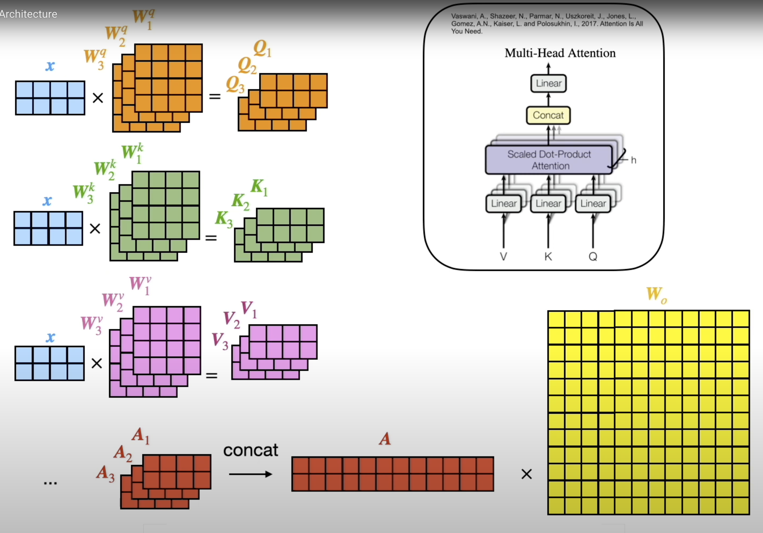
Notes:
So then we had multi-head attention. So what is multi-head attention again. Multi-head attention is, yeah, repeating this whole process in parallel.
So this is, again, from the original paper. So we are now repeating this age times, and then concatenate the results. And then apply a fully connected layer.
So here, I try to visualise it by having three matrices instead of one, so we get three queries, and so forth, and that's, you know, of course, as a true for the keys and the values, and you can think of them as different slices, or different layers, and you can compute all of these age ones in parallel. Then you concatenate them, so you get these ace, if I go back one side, so you get H times this A, and then you concatenate those. And then you multiply it by weight matrix, and this is a fully connected part here.

Slide 57
Notes:
Yeah, so here it is, here, that's the transformer architecture. And yeah, I know it looks pretty complicated at first glance. There are lots of little details, but we will be able to understand it by, yeah, tackling it one thing at a time.
So I made a couple of slides where I will explain all these little details going on here. So in this slide, let's start with the big picture. So we can see the big picture is that we have two parts and encoder.
And decoder here. And the encoder receives input words, so that could be a sentence, it will reproduce, uh, representation of that, that is then passed to the decoder, together with outputs, shifted outputs. I will get back to that later in a later slide.
But the big goal here is that it will produce the output probabilities for the words to be generated. So it's generating a sentence, and you can think of it as, let's say, translating a sentence. It reads an input sentence, and then
it translates the sentence by generating one word at a time.
And there are some familiar parts to it. So, first of all, notice we have the multihead attention here. That is what we talked about in the previous slide so much.
So that's the multi detention from the previous slide that we talked about. It also appears here, and here, there's actually a masked version. We will talk about the masked version, also in a separate slide.
Other things you might notice here is also, yeah, that we have skip connections. So these skip connections are essentially the residual connections that we talked about in the residual network, in the scene N lectures, similar concept, where we add the input to the output of something that went through a layer, right? So what we are doing here is we are, let's say, taking this one, this input here, and we are adding it at this stage after the multihead attention layers.
We're doing the same thing here. So here we are optionally skipping the feet forward network. So, for instance, if this is not learning anything useful, then we will have just forwarded the input here.
So this skip connection is essentially adding it. And this is also why, we have certain dimensions. So, originally the input embedding here is the sentence length T. Times 512.
So we have input embedding size of 500 12 in the original paper. They define it as 512. And what comes out of here, of the motiate attention, is also a 512 dimensional embedding that is so that we can then add those together.
So that's why we have the same dimensions. Same is true for here and here. So the multilayer perceptron layers here, feet forward, or multilayer deceptron layers.
They also, they are matrix, essentially, WO, which is 500, 12 is the number of columns. So it's 500, 12 times 500, 12. What else?
Yeah, I think this is maybe it for this slide, so I don't want, like I said, I don't want to talk too much about every detail in one particular slide, because then it gets too cramped. Maybe one more thing, highlighting here, there are more residual connections, also, in the decoder.

Slide 58
Notes:
Speaking of which, so the encoder and decoder parts are also repeated, so you can maybe see in a small fund, there is this NX, so this just means that they are repeating the encoder blocks and decoder blocks a couple of times.
So, in fact, in the original paper, they repeat that six times, so we have six in corners, and six decoders. The structure of the encoders and the decoders the same is just repeated. No weight sharing.
They are separate, so they are separate encoders, but they have exactly the same structure,

Slide 59
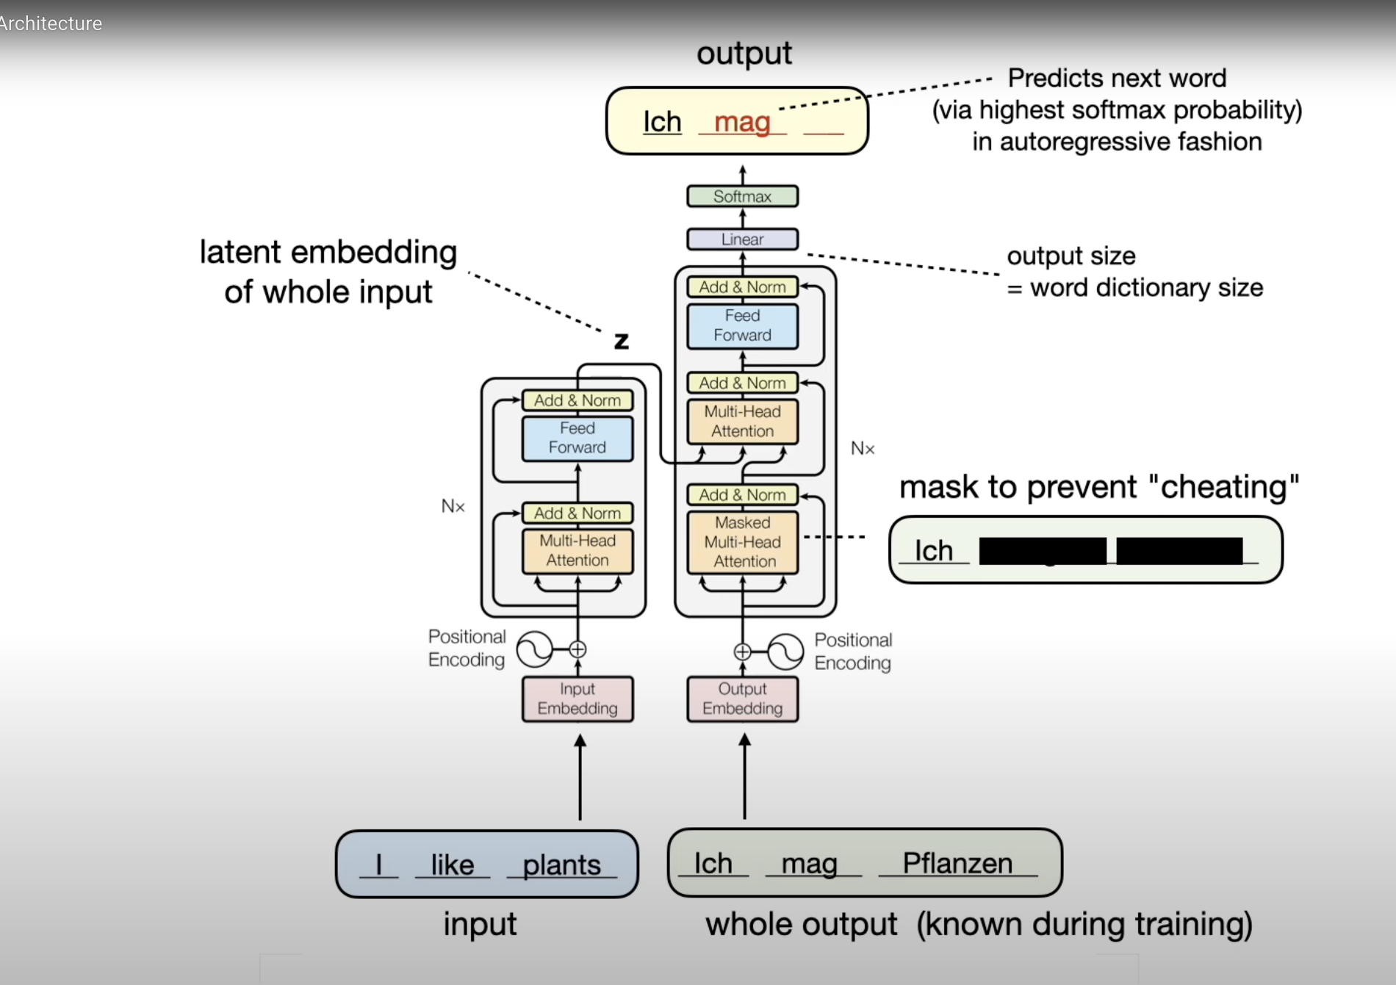
Notes:
and the same is true for the decoders. So next, let's talk about masked multi-head attention. So what's that now?
Do we need another video about masks, multihead attention? Don't worry, it's essentially the same concept as the multihead attention, except we are masking some inputs in the sequence. So essentially it's about masking subsequent sequence elements.
So here, the decoder is generating one word at a time, and let's say we are having a sentence consisting of 10 words, we are currently generating word five. So we would be at this stage, masking, words 6, 7, 8, 9, and 10 that are already present in the training data set. So if we have the training data, so we have access to the full sequence, but we are masking those 1st that, um, that are not generated yet essentially.
So, this will allow the model to attend to positions up to, and including the current position, and how this masking works is by setting values, and simple to the softmax to minus infinity, so that when softmax processes them, there will be 0 probabilities. So, um, this might look a bit, yeah, obscure. So I made another slide illustrating this masking one second.
So let's consider, we have the input sentence, I like plants, and we want to translate it into German. So the correct German translation would be ich mark flansen. And this is known during training.
When we're training
this transfer, we know the correct translation. But yeah, when we're training it, we are training the model to produce one word at a time. The input is provided as full.
It will produce an representation of that input. But then, let's say, we have already generated the word ich, and we are currently about to predict the word, the second word. This is what we want to predict next.
We are giving the model the whole sequence here is input. But it would be kind of cheating if we would show the model, these two words, because these have to be generated. We assume right now, only the first word is generated.
So it would be cheating, right? Just giving access to these words to the model here at this stage. So we are masking them.
So here, that's what I try to illustrate. We are masking these words, so it doesn't have access to them yet. Once it has, let's say, generated these 2 words, we will unmask this word and only mask the last word that it has to generate and so forth.
Yeah, one more detail here. So, the output size, when we're predicting here, this is one, yeah, computationally expensive step, because the outputs here are the predicted probabilities for each word in the dictionary. So if you have a dictionary, if you think back of the RNN, the examples of the RNN, when we had the word, or an info classification, I think we had a dictionary size of 20,000.
So we have 20,000 probabilities for each word, and then we pick the word with the highest probability, and get the index for that, and then this is our predicted word at this given position. So, let's see, by the highest, soft mix, probability in an auto regressive fashion, which means essentially one word at a time. And the output size here of this linear layer is, yeah, the verted dictionary size, like I mentioned, which goes to the soft mix phenomenization, and then we pick the largest one, and then, yeah, the learning is my cross entropy here.

Slide 60
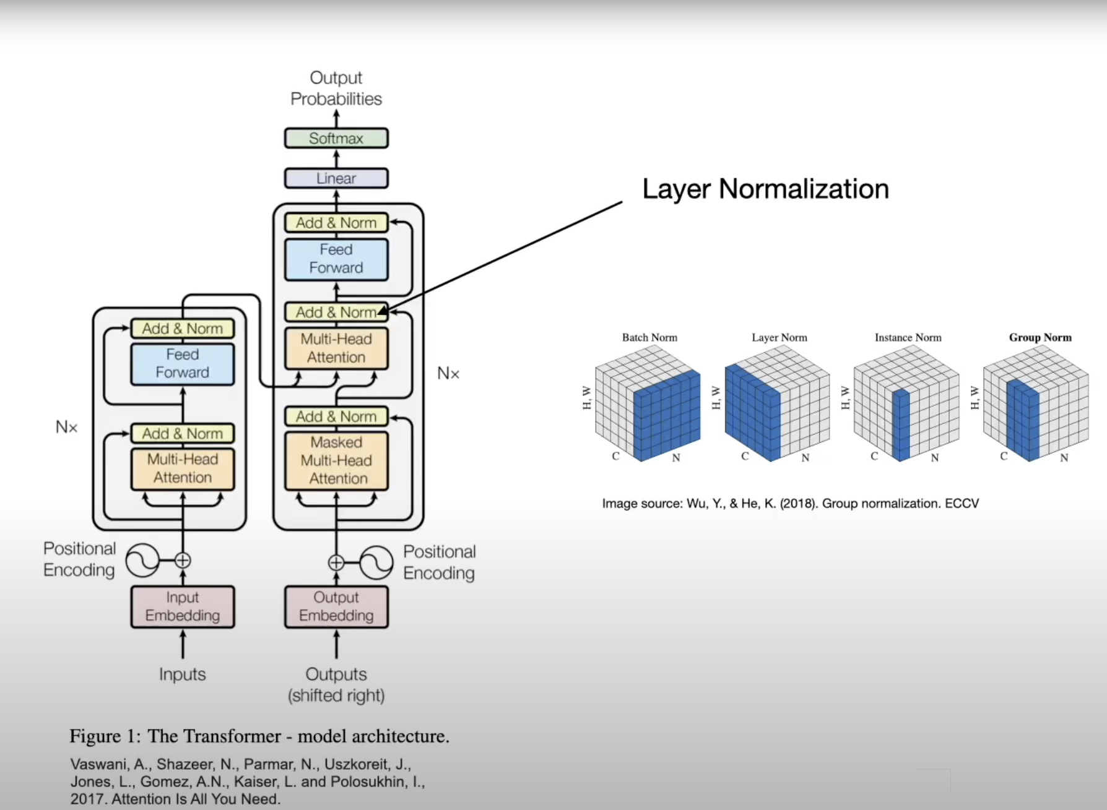

Slide 61
Notes:
Lastly, to finish things up, here's an example of how attention values look like from the original paper. So, if you think of attention values, as values between 0 and 1, the attention mask, so, if you think back off the QK, um, T, and then normalised, so, if you, and then through the, OK, it's through the soft max.
So if you think of these, we can look at the attention values for each word, towards each other work, right? And this is what's shown here. So for instance, when you look at the word law, it's kind of strongly connected.
So the saturation here of the colours is how strongly it is connected, so you can see it's mostly connected to this here. It's the strongest connections, maybe this one has a slight connection also to things further away here. But very weak connection to the missing, to the middle parts here.
So yeah, this is just a visualisation. And here in this visualisation, it's shown for attention head, let's see, five, and had six, and you can see, that it's actually not redundant to have multiple attention heads, you can see, this pattern here is very different, let's say, from this pattern. So the attention head is actually, having different attention heads is actually useful, so it's learning different things in these different attention heads.

Slide 64
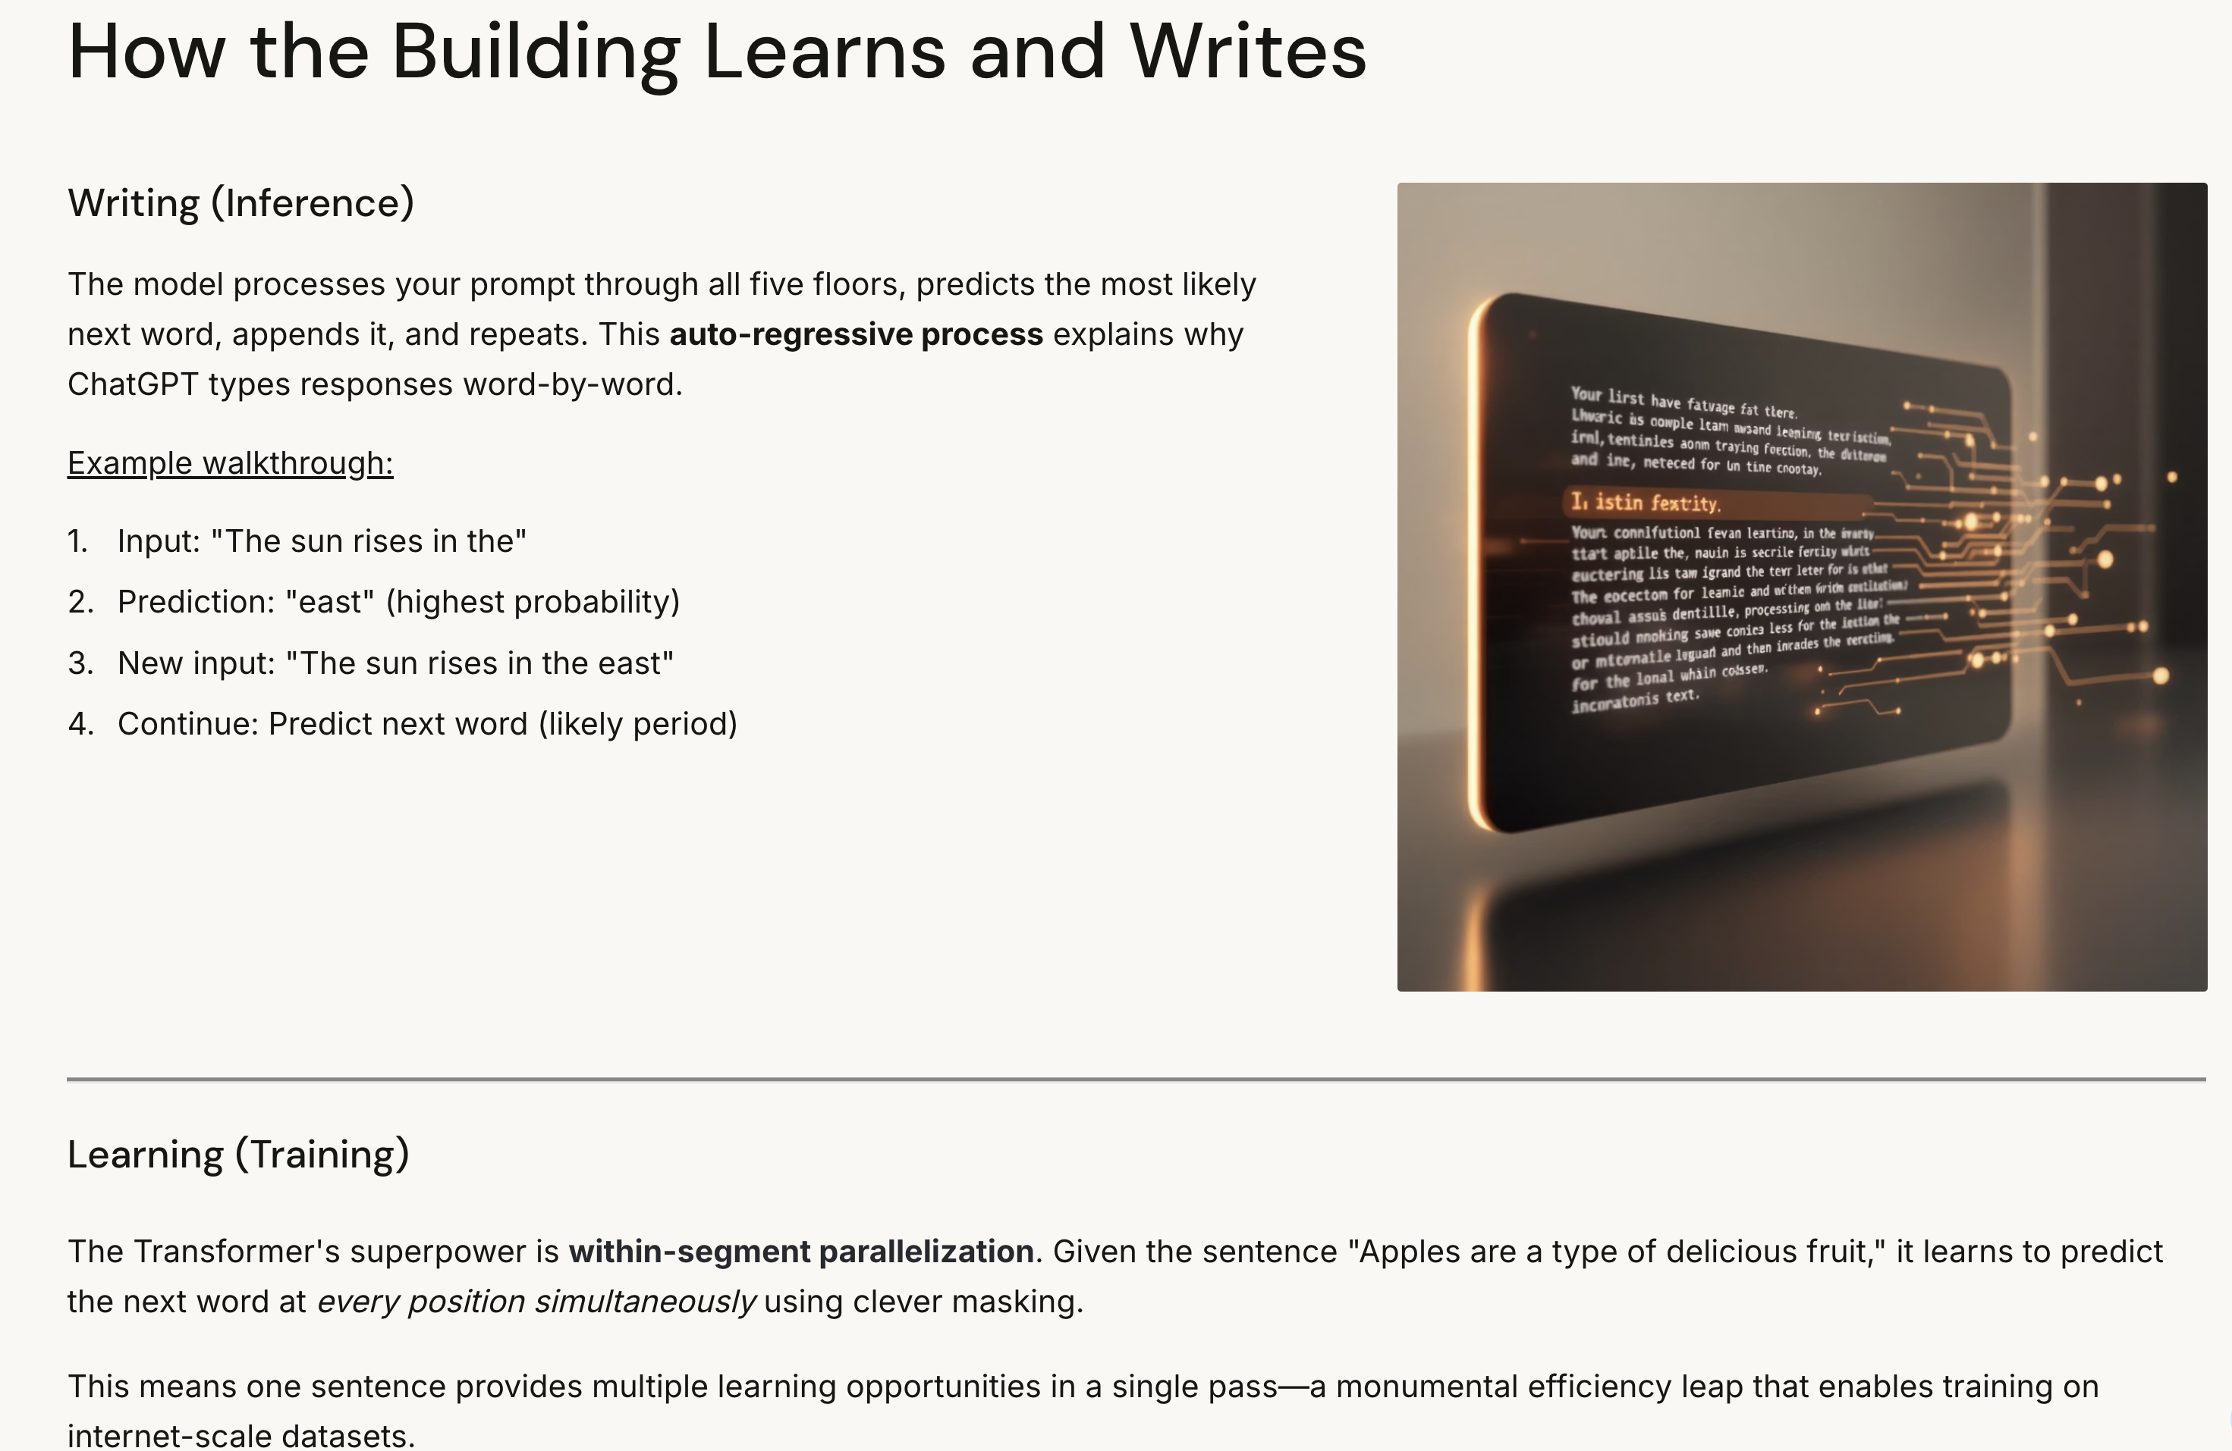

Slide 68
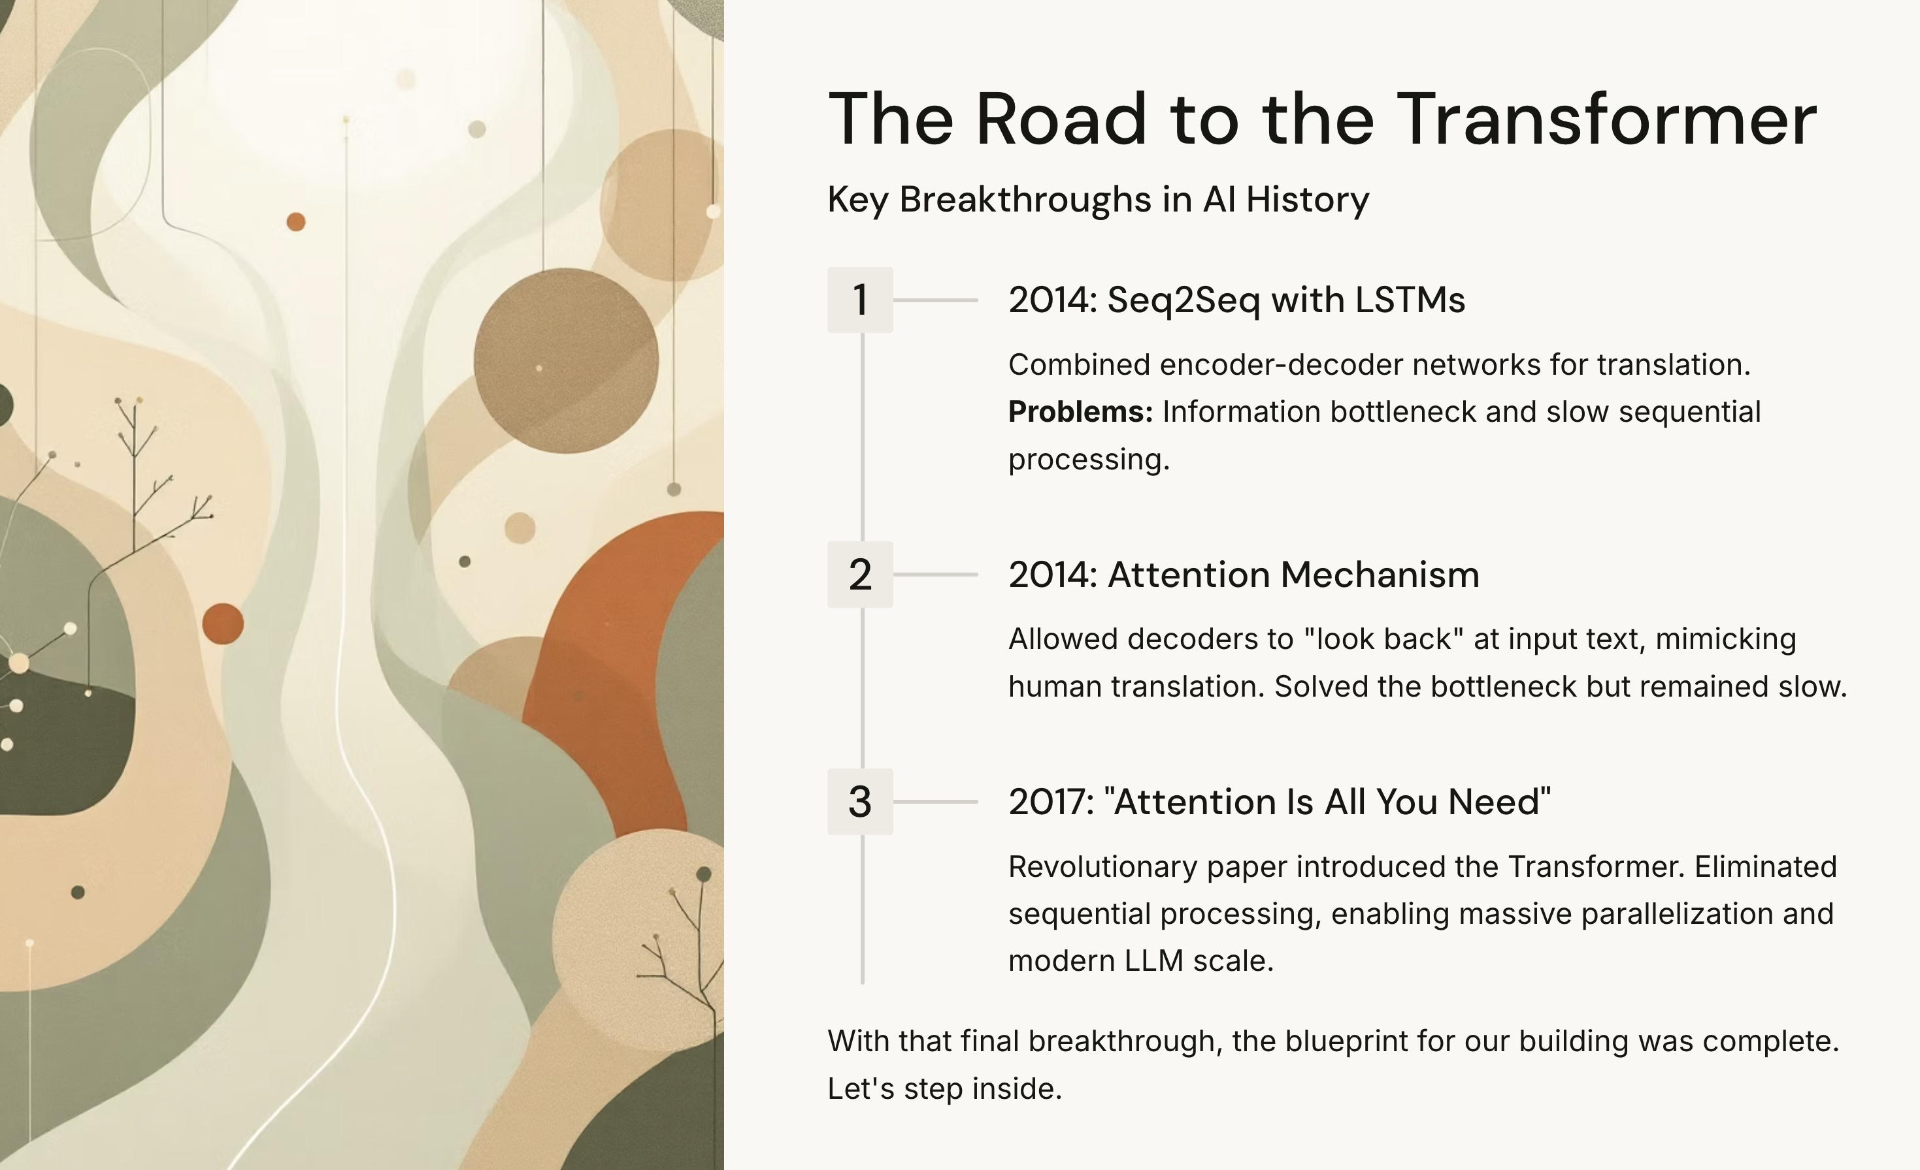

Slide 69

Sequence Generation with RCNN
The Unreasonable Effectiveness of Recurrent Neural Networks by Andrej Karpathy

Slide 70
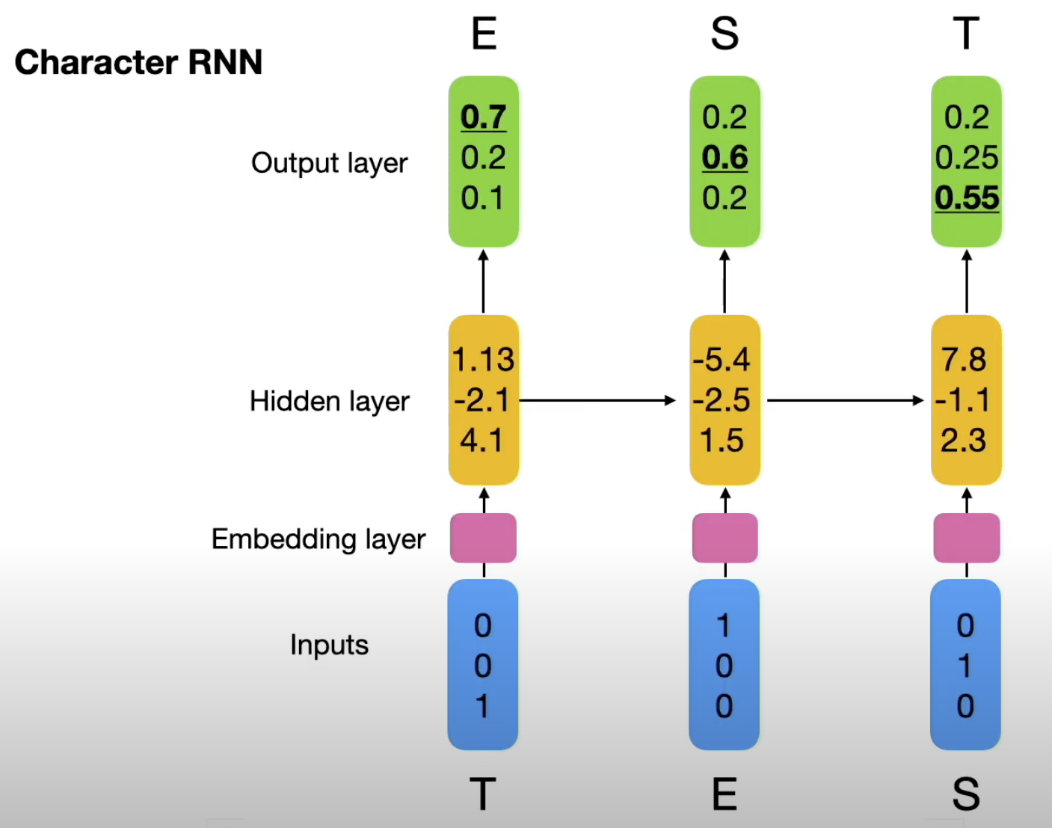

Slide 71
RNN with Attention mechanism
Challenge in language translation: memorize input sensate in one hidden state

Slide 72
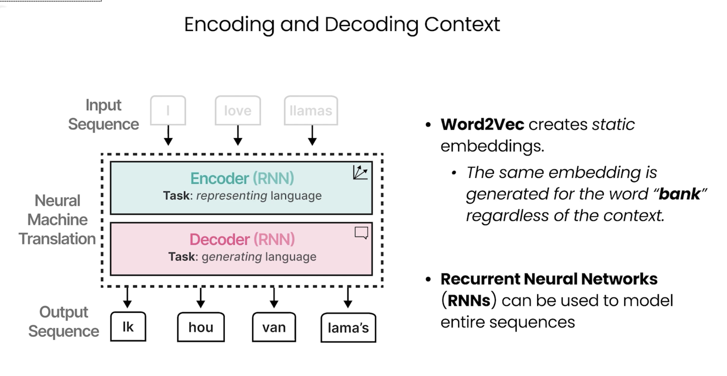
Notes:
The same embedding is generated for the word bank, regardless of the context. Bank can refer to both a financial bank, as well as the bank of a river. Its meaning, and therefore, its embedding, should change depending on the context. Capturing text context is important to perform some language tasks. such as translation. A step in encoding this text was achieved through recurrent neural networks, or RNNs. These are variants of neural networks that can model sequences as an additional input. To do so, these RNNs are used for two tasks, encoding or representing an input sentence, and decoding or generating an output sentence. Let's explore this by showcasing how this input sentence, I love llamas, gets translated to Dutch. The text is past the encoder, which attempts to represent the entire sequence through embeddings. The decoder, then uses those embeddings to generate language. Here, it translated the English, I love llamas, to the Dutch Ikau von llamas. Each step in this architecture is auto regressive. When generating the next word, this architecture needs to consume all previously generated words. For instance, you take the input eye of llamas. The model then generates the first open, which is ick. To then generate the next open, the output ick is appended to the inputs. In step two, the input is now I love llamas, egg, which, in turn, generates the output. How? You can continue this process at each step and continuously update the input with a previously generated token. until the entire output is generated.

Slide 73
KING – MAN = QUEEN

Slide 74
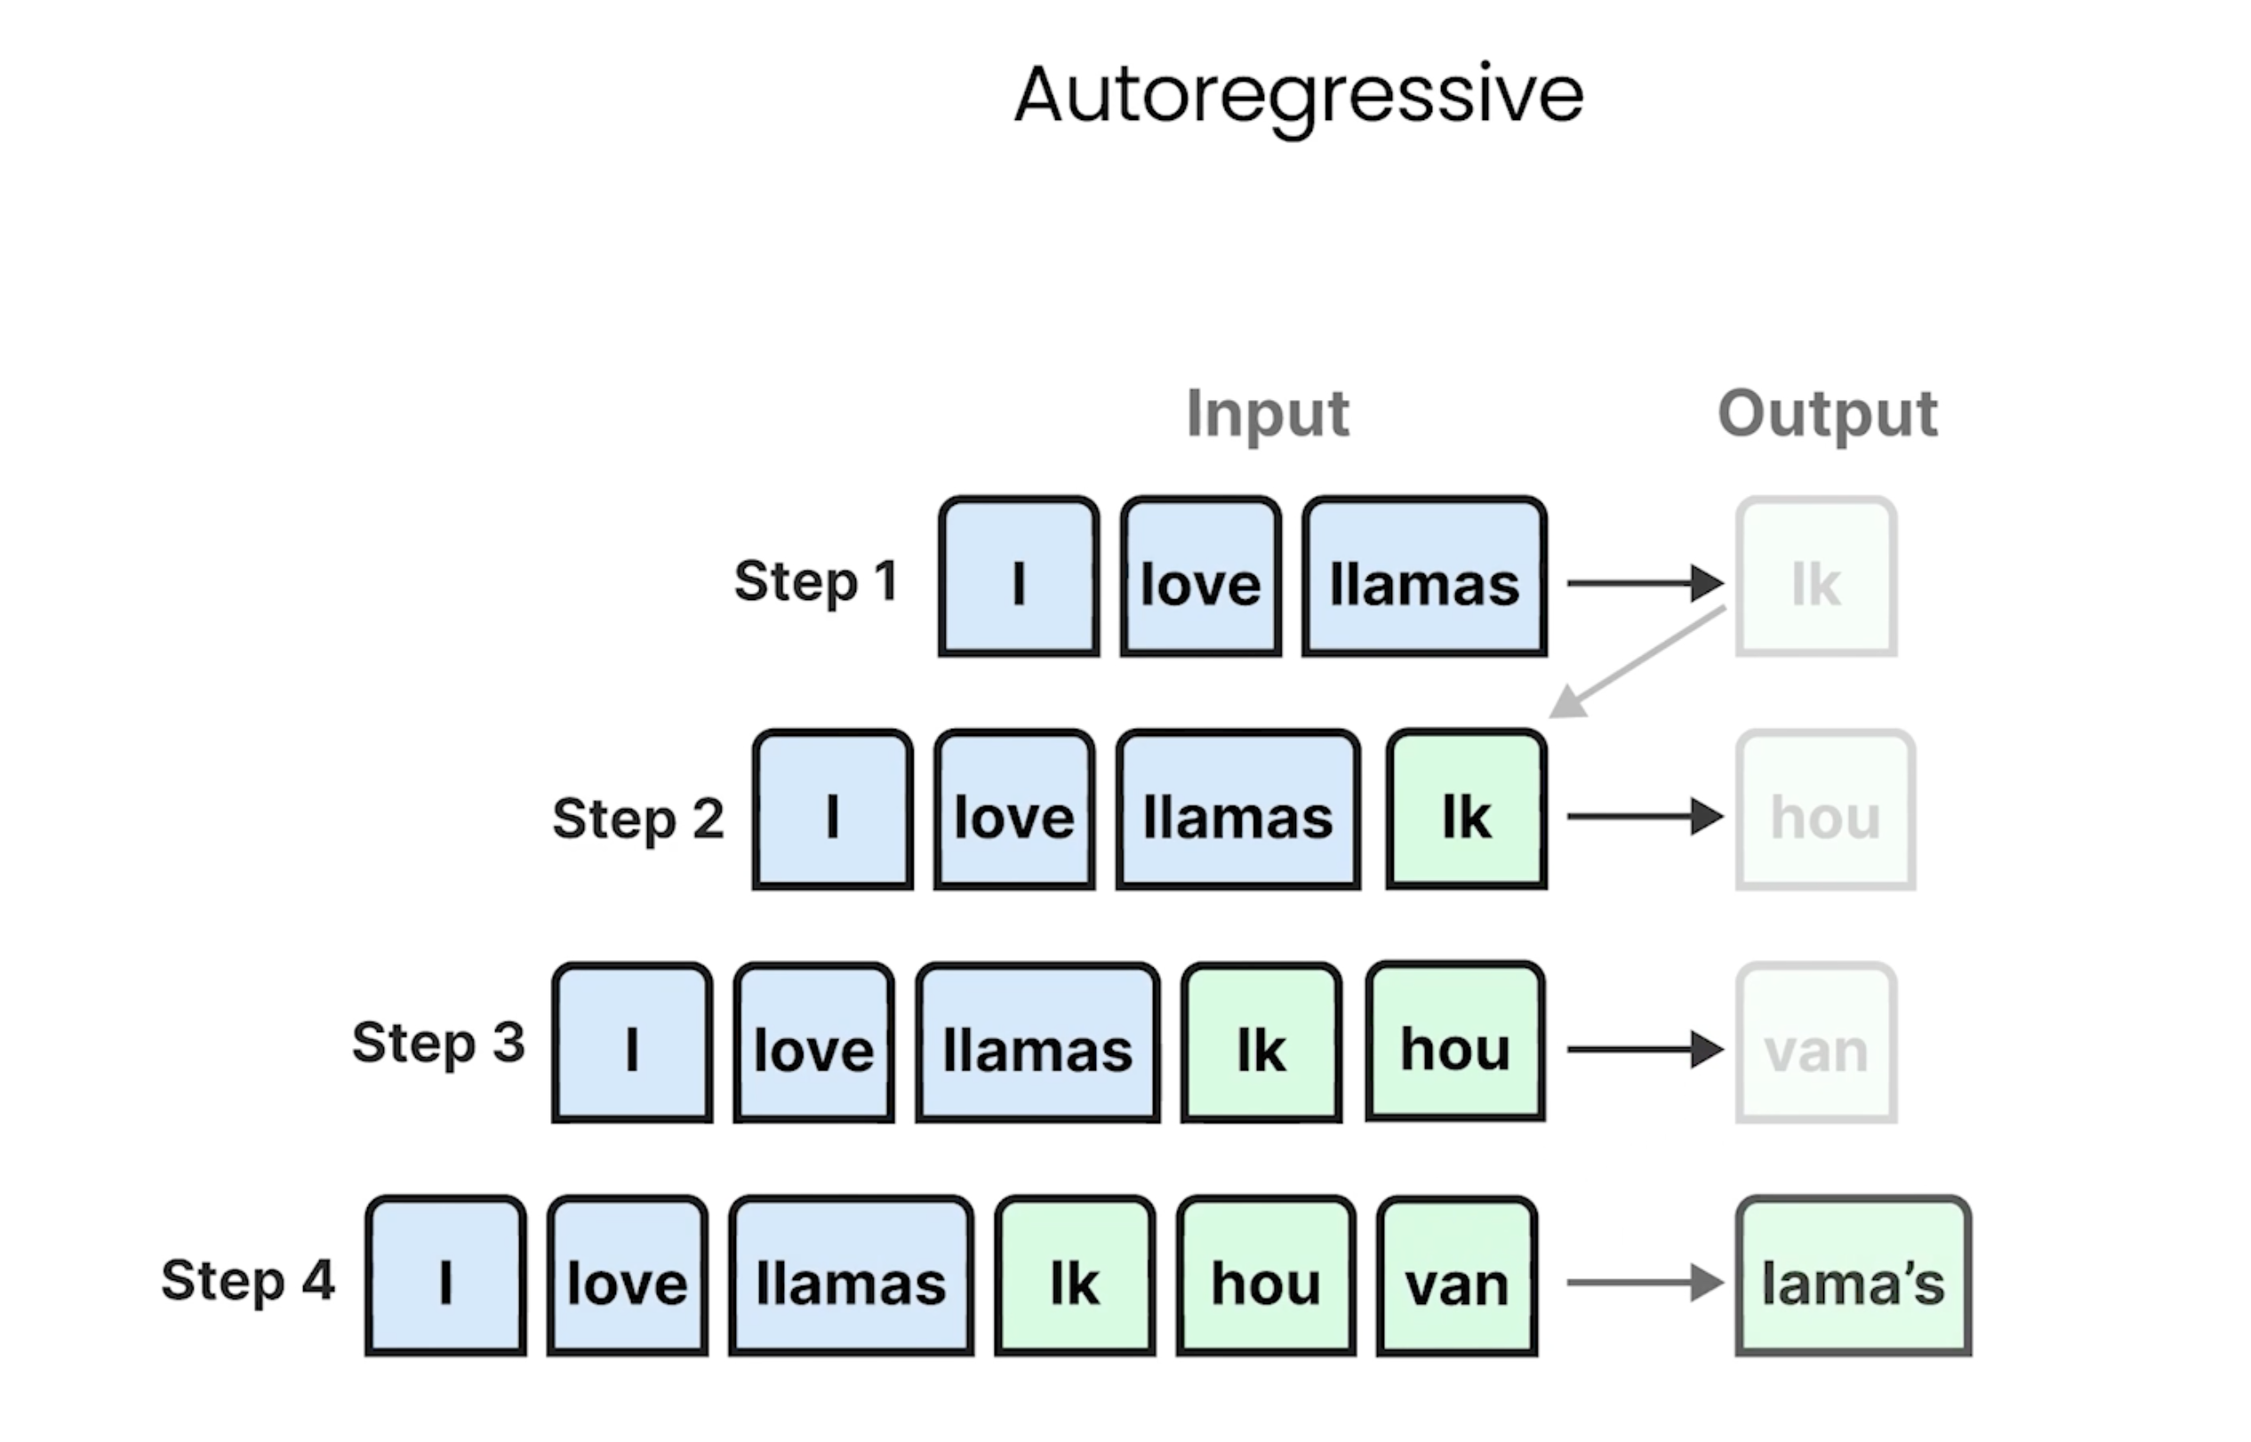
Notes:
Most models are autoregressive, meaning they generate a single token at a time. Let’s explore how encoding and decoding work in more detail.
We begin with the input sentence “I love llamas”, which is tokenized into individual tokens. These tokens are then converted into embeddings using a word embedding method.
Although embeddings by themselves are static, the encoder processes the entire sequence at once. This allows it to take into account the context of each token within the whole sequence. The purpose of the encoding step is to create the best possible representation of the input sentence. The result is a contextual embedding — a representation that captures both the meaning of individual words and their relationships within the sentence.
Autoregressive models
Generate one token at a time.
Each new token depends on previously generated tokens.
Start with the input sentence
Example: “I love llamas.”
Sentence is split into tokens: [“I”, “love”, “llamas”].
Token embeddings
Each token is mapped to a numerical vector (embedding).
These embeddings are initially static, meaning they only represent the word itself, not the context.
Encoding step
The encoder processes the entire sequence of embeddings at once.
It looks at the relationships between tokens (context).
Produces contextual embeddings: richer representations that capture meaning based on both the word and its surroundings.
Purpose of encoding
Create a comprehensive representation of the input sentence.
This representation is then passed on to the decoder (in models that use an encoder–decoder setup).

Slide 75
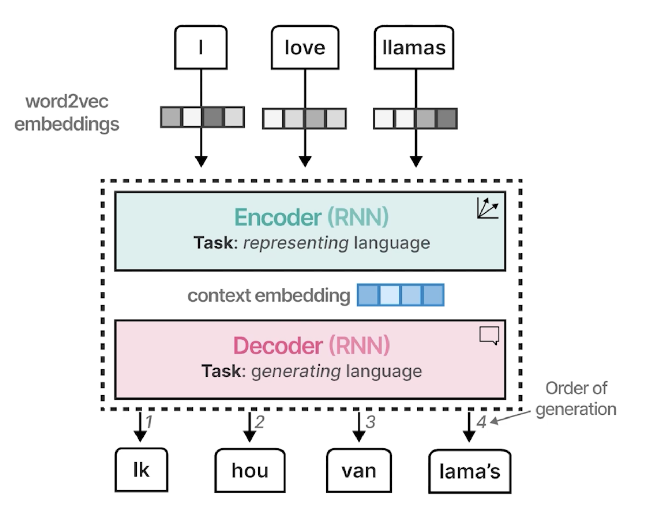
Notes:
This decoder, in turn, is in charge of generating language. And does so by leveraging the previously generated context and value. to eventually generate the output. As we explored previously, these output tokens are generated one at a time, which is called although regressive. This context embedding, however, makes it difficult to deal with longer sentences, since it is merely a single embedding representing the entire input. So the single embedding might fail to capture the entire context of a long and a complex sequence
Decoder’s role
Responsible for generating language output.
Uses the context embedding (from the encoder) plus the previously generated tokens.
Autoregressive generation
Tokens are produced one at a time.
Each new token depends on:
The context embedding.
All tokens generated so far.
Limitation of a single context embedding
If the encoder produces only one embedding for the whole input, it struggles with longer sentences.
A single vector may fail to capture all nuances of a long or complex sequence.
This motivates more advanced architectures (e.g., Transformers with attention) that handle context more effectively.

Slide 76
Today
is
a
great
day
Hoy
es
un
gran
dia

Slide 77


Slide 78

Notes:
Attention mechanism was introduced to fix these issues.
Instead of relying on one compressed embedding, attention:
Allows the model to focus on specific parts of the sequence that are relevant.
Assigns attention weights to relationships between words.
Example:
Words with closer meaning (“I” and “the Dutch” as synonyms) → higher attention weight.
Words less related (“I” and “llamas”) → lower attention weight.
In the decoder step, attention provides signals for each input token, guiding which words matter most when generating each output token.
In 2014, a solution called attention was introduced that highly improved upon the original architecture. Attention allows a model to focus on parts of the equity sequence that are relevant to one another. or attend to each other. and amplify their signal. Attention selectively determines which words are most important in a given sentence. Take our inputs and output sequences, for example, words with similar meaning, like I and the Dutch, which are synonyms of higher attention weights, since they are more related. I and llamas have lower attention weights, since they do not relate much to each other in this particular sentence. And the same applies to all other words. By adding these attention mechanisms to the decoder step, the R&M can generate signals for each input word in the sequence related to the potential output.

Slide 79

Notes:
You can, again, represent the in producing word to VAC and Bannix and bulse those to the encoder. Instead of passing only a context embedding to the decoder, the hidden states of all input words are passed to the decoder. State for a word is an internal factor from a hidden layer of a RNN that contains the information about the previous words. The decoder then uses the attention mechanism to look at the entire sequence. Finally, this, again, generates a language, due to this attention mechanism, the output tends to be much better, since you now look at the entire sequence using a betting for each token a word. Instead of the smaller and more limited context symbolic. So during generation, the model attends to the most relevant input. After having generated Ikhao Fong, using the input I love llamas, the attention mechanism then highlights words that are more relevant in this particular example. The sequential nature of this architecture precludes parallelisation during training of the model. Let's go to the next video and learn how attention is used in transformer models.
Encoding with hidden states
Instead of producing just one context embedding, the encoder now outputs the hidden states of all input tokens.
A hidden state is the internal representation from an RNN layer that captures information about the word and the words before it.
Passing hidden states to the decoder
The decoder receives the full sequence of hidden states, not just one compressed vector.
Decoder with attention
Uses the attention mechanism to look at the entire sequence of hidden states.
Assigns weights to input tokens based on how relevant they are to the token being generated.
This means that during generation, the model can “focus” on the most important words.
Improved output
Produces much better results because the model considers the full sequence with per-token context.
Example: when generating a translation or output, the attention highlights which input words are most relevant at each step.
Limitation
RNN-based architectures (even with attention) are still sequential by nature.
This makes training and inference slow and hard to parallelize.

Slide 80


“… allowing a model to automatically (soft-)search for parts of a source sentence that are relevant to predicting a target word …”
NEURAL MACHINE TRANSLATION BY JOINTLY LEARNING TO ALIGN AND TRANSLATE, ICLR 2015
Notes:
For different words we have acess to the whole sentence, and look into what parts are relevant to the sentence?
BLEU score is a score to compute how good is the quality of the translation → a highes score is better.
They did experience with different sentences lengths.
For long sentences the performance declines when not using attention mechanism.

Slide 81
Attention Mechanism
Assigning attention weight to each word, to know how much “Attention” the model should pay to each word
(i.e. for each word, the network leanrs a “context
”)

Slide 82
Notes:
This decoder, in turn, is in charge of generating language. And does so by leveraging the previously generated context and value. to eventually generate the output. As we explored previously, these output tokens are generated one at a time, which is called although regressive. This context embedding, however, makes it difficult to deal with longer sentences, since it is merely a single embedding representing the entire input. So the single embedding might fail to capture the entire context of a long and a complex sequence

Slide 83

1st Translated Word
Hidden State in a regular RNN
(RNN #2)
Attention Weight
Bi-direccional RNN (RNN#1)
1st Input word
NEURAL MACHINE TRANSLATION BY JOINTLY LEARNING TO ALIGN AND TRANSLATE, ICLR 2015
Notes:
Outline the whole mechanism of attention: notice two RNN
Bi-dioreccional RNN → Just running RNN forward and backward (or twice, one time in regular order and one time by having the sentence putting in the reverse order)
Bidireccional → compute attention weights → then itr goes to regular RNN and recives the attention weights and the previous state.

Slide 84

Notes:
Contexxt vector the sum of attention weight alpha multiplied for the hidden representation.
Hidden activbation is the concatenation of the hidden
2 sets of hidden actibvation one for the forward and one for the backward → so simple concatenate the hidden states, this is called h1, the hidden activbation.
Attention combines the hidden states the attention weights
Context vector provides information about the whole sequence → in a regular RNN this will be encoded in the previous time step alone, but information can be easily lost.
This help us to take a look to the whole input sequence.
C1 is computed by talking all attention weights with the hideden layers.
If word is not important the attention weight will be close to zero.
How do we compute the attyention weight?

Slide 85

Notes:
Compute weight using a MLP → NN → Takje the information from current time step and information from the hidden staten previos …
The normalize using softmax so the attention weights sum up to one.

Slide 86


Slide 87


Slide 88


Slide 89


Slide 90


Slide 91
Repesent language as a bag of words.

